Slide 1
Phytoremediation of soils contaminated by inorganics
BIOREMEDIATION AND PHYTOREMEDIATION

Slide 2
Content
Introduction
Phytotechnologies for remediation of inorganics
Plant specifics for remediation of inorganic compounds
Experiments and case studies

Slide 3
Phytotechnology mechanism summary
Pollutant | Description | Pollutants type addressed
Phytoextraction | Plants extract metallic and organic compounds from soil to plant tissue. | Inorganic
Phytostabilization | Plants mechanically stabilize polluted soils, and prevent bulk erosion and airborne transport to other environments. | Organic and Inorganic
Phytotransformation/ Phytodegradation | Plants mineralize or assimilate contaminants in soil or water. | Organic
Phytostimulation/ Rhizodegradation | Soil biology (microbes) in root zone of plants destroy contaminants | Organic
Phytovolatilization | Plants turns it into a gas and released into the atmosphere | Organic and Inorganic

Slide 4
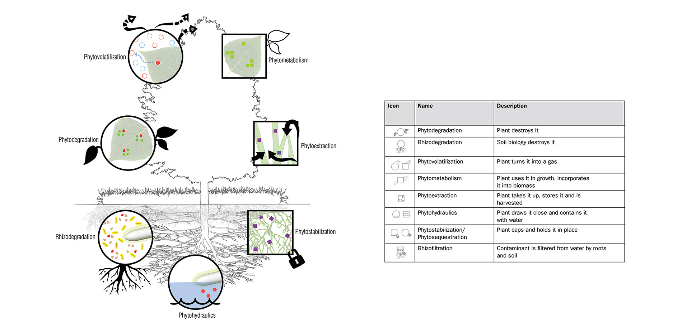
Kennan and Kirkwood (2015)

Slide 5
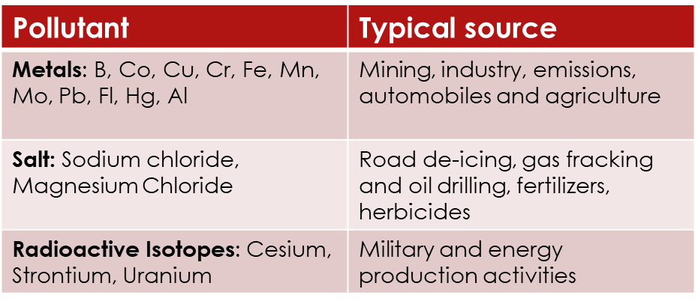
Introduction
Common inorganic pollutants successfully degraded at field scale
Inorganic contaminants: Naturally occurring elements such as lead and Zinc.
Human activities such as burning of fossil fuels, industrial production and extraction mining create releases of inorganic pollutants into the environment causing toxicity.
Inorganic elements can exist in many forms: anions, cations, oxidized, or as solids, liquids or gases.
Common inorganic pollutants not successfully degraded at field scale

Slide 6
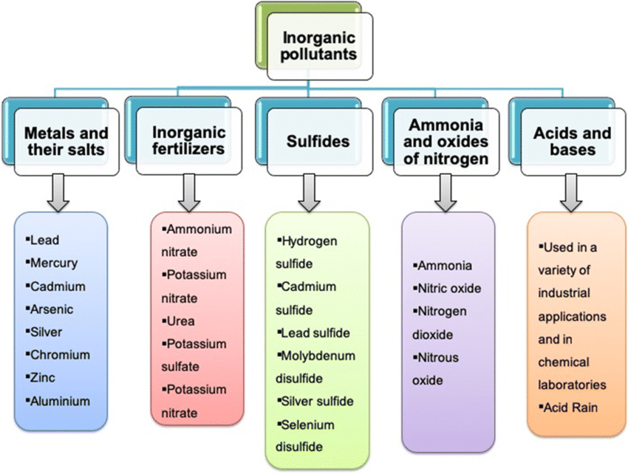
Mishra et al. (2019)

Slide 7
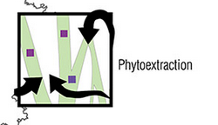
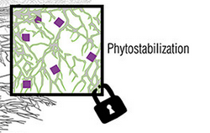
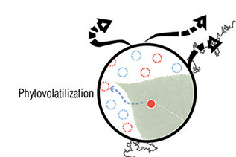
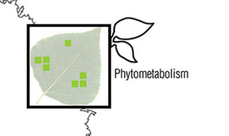
Phytotechnologies for remediation of inorganics
The two most commonly used phytotechnologies for inorganic contaminants are phytoextraction and phytostabilization.
Kennen & Kirkwood (2015)

Slide 8
Principles of inorganic phytotechnologies
Hyperaccumulators: Plants that extract high number of pollutants
High-biomass plants.
Bioavailability: The availability of a pollutant in soil accessible for a plant to uptake. This can be influenced by various factors such as the charge (anion or cation) the pollutant is present, pH, acidity of soil, etc.
Chelants: Chemicals added to soil to increase extraction of pollutants (e.g. Oxalic acid, citric acid).
Excludes and stabilization.
Soil amendments to support stabilization of TEs that are not bioavailable.

Slide 9
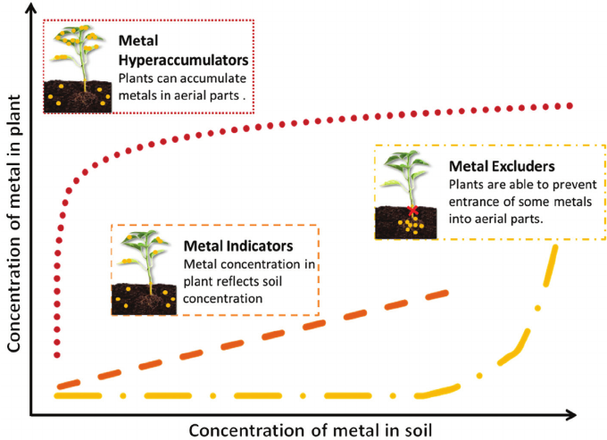
Plant specifics for remediation of inorganic compounds
Based on the relative uptake and bioaccumulation potential, plants can be grouped into three categories: excluders, indicators, and accumulators.
Three groups of plant categories based on their uptake behavior of trace elements: excluders, indicators, and accumulators (Erickson and Pidlisnyuk, 2021. Modified from Hunt et al., 2014).

Slide 10
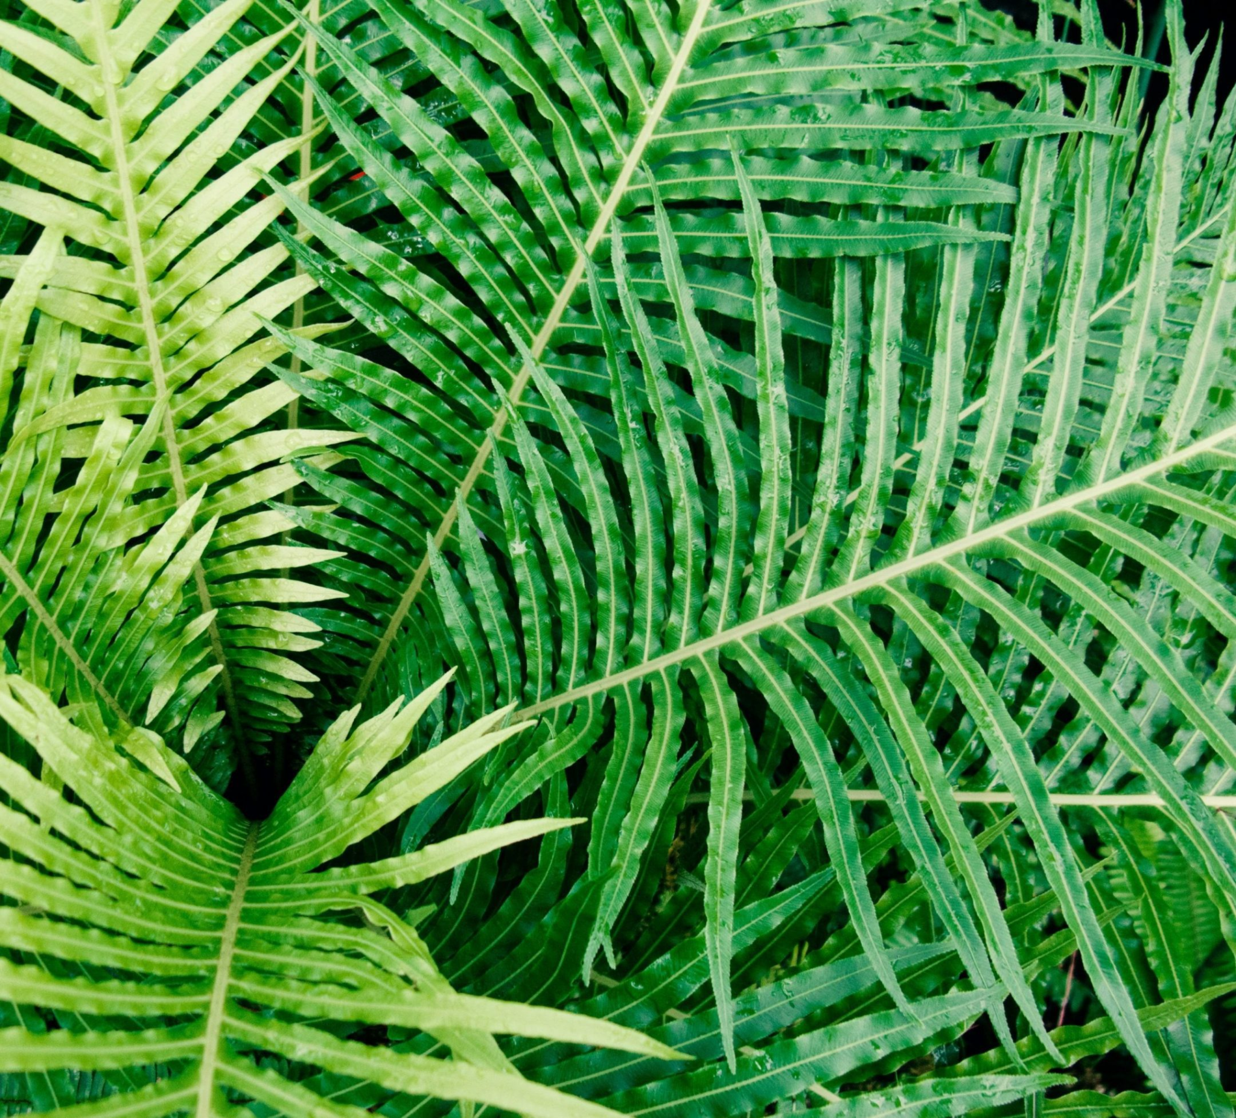
Plant specifics for remediation of inorganic compounds
Hyperaccumulators
Hyperaccumulators are plants that contain more than or up to 0.1% i.e. more than (1000 mg/g) of copper, cadmium, chromium, lead, nickel cobalt or 1% (>10,000 mg/g ) of zinc or manganese in the dry matter. For cadmium and other rare metals, it is > 0.01% by dry weight (Baker and Brooks, 1989).
Ladder brake ferns hyperaccumulate toxic arsenic (Indrioloet al. 2010).

Slide 11
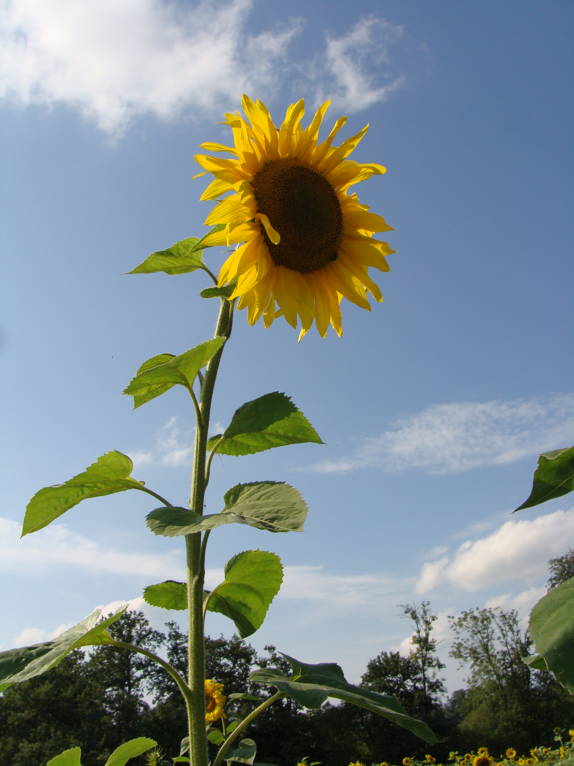
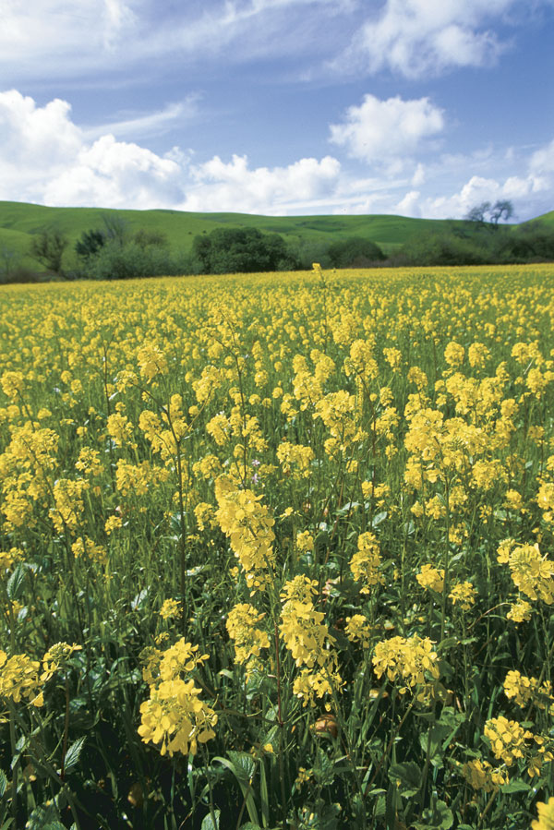
Plant specifics for remediation of inorganic compounds
High-biomass plants: These are plants considered as ‘accumulators’ and they uptake a large amount of contaminants.
Concentrations of contaminants will be less than that of hyperaccumulators, but are easier to grow and readily available
E.g. sunflowers, mustard, soybeans and corn.

Slide 12
Plant specifics for remediation of inorganic compounds
Hyperaccumulators or high biomass crops are used for the phytoextraction of TEs from the environment.
Two types of phytoextraction are commonly discussed in literature:
Chelate assisted phytoextraction or induced phytoextraction, in which artificial chelates are added to increase the mobility and uptake of metal contaminant.
Continuous phytoextraction is the removal of metal depending on the natural ability of the plant to remediate; only the number of plant growth repetitions are controlled.

Slide 13
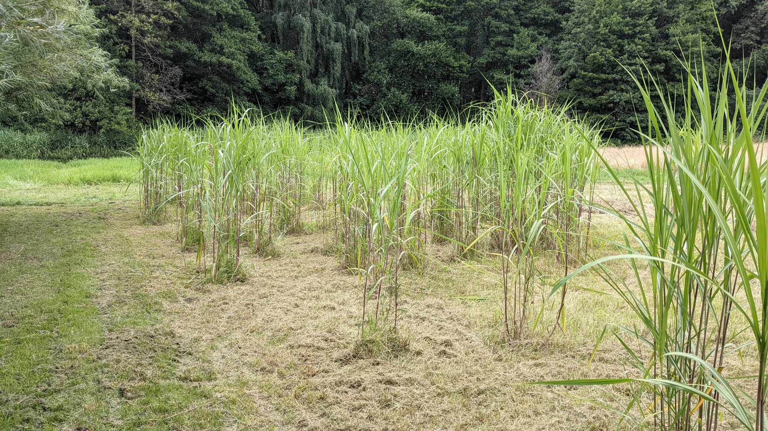
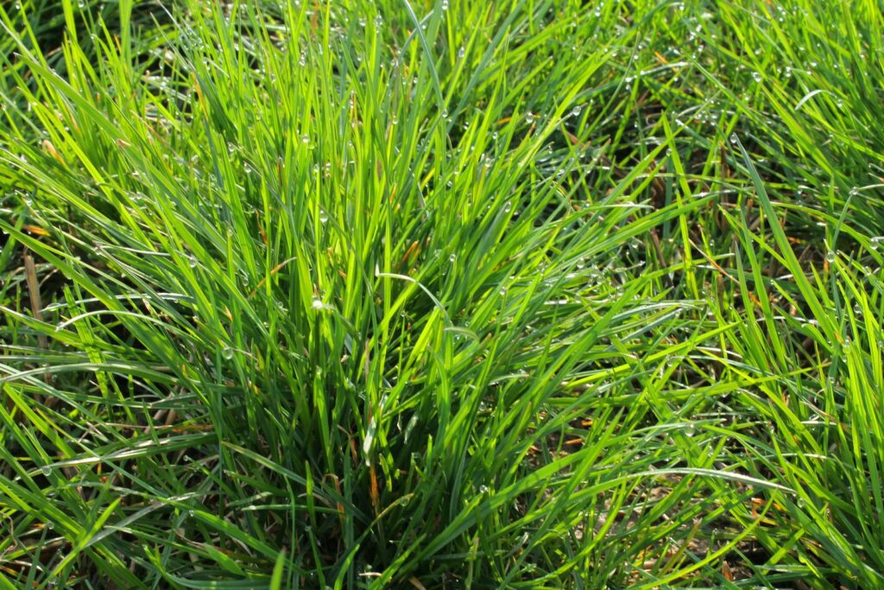
Plant specifics for remediation of inorganic compounds
Excluders/Stabilizers: Plants that stabilize/immobilize contaminants on site are suitable with the support of amendments for TEs with limited bioavailability to be extracted.
Miscanthus
Perennial ryegrass

Slide 14
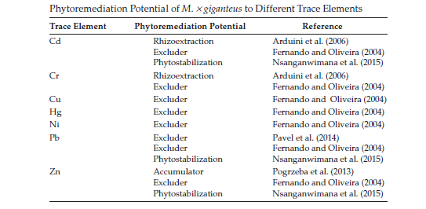

Slide 15
Plant specifics for remediation of inorganic compounds
There are two types of plants suitable for a phytostabilization process.
One group is formed by plants tolerant to high concentrations of contaminants, i.e., trace element excluders.
Another group is represented by species with highly developed root systems that can immobilize contaminated substances through uptake, precipitation, or reduction. contaminants are usually concentrated in the roots and only a small portion of contaminants can move to the aboveground part of the plant.
Soil amendments are often used to support phytostabilization of TEs that are not bioavailable.

Slide 16
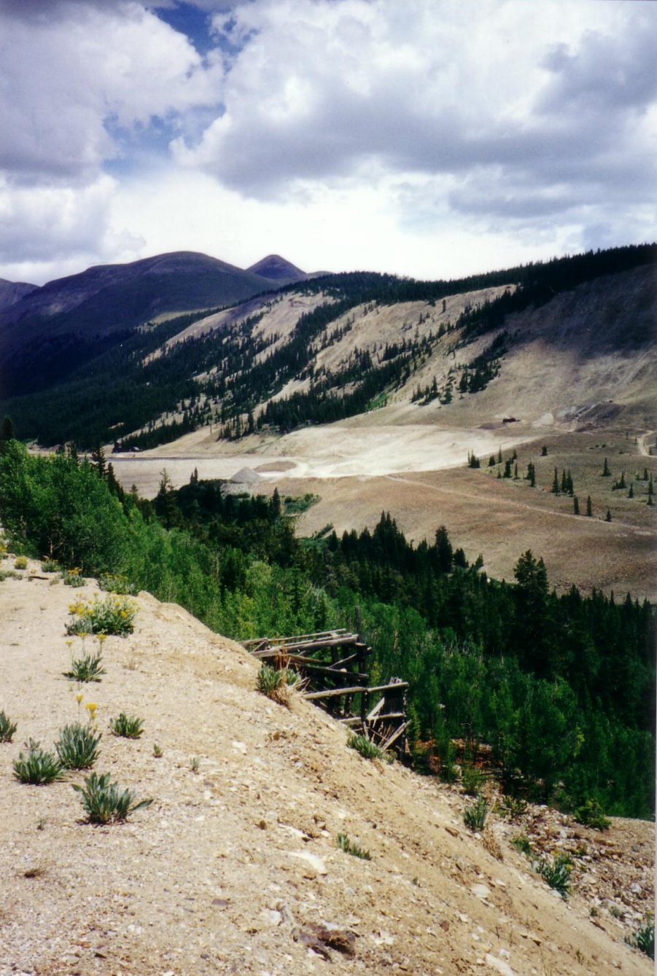
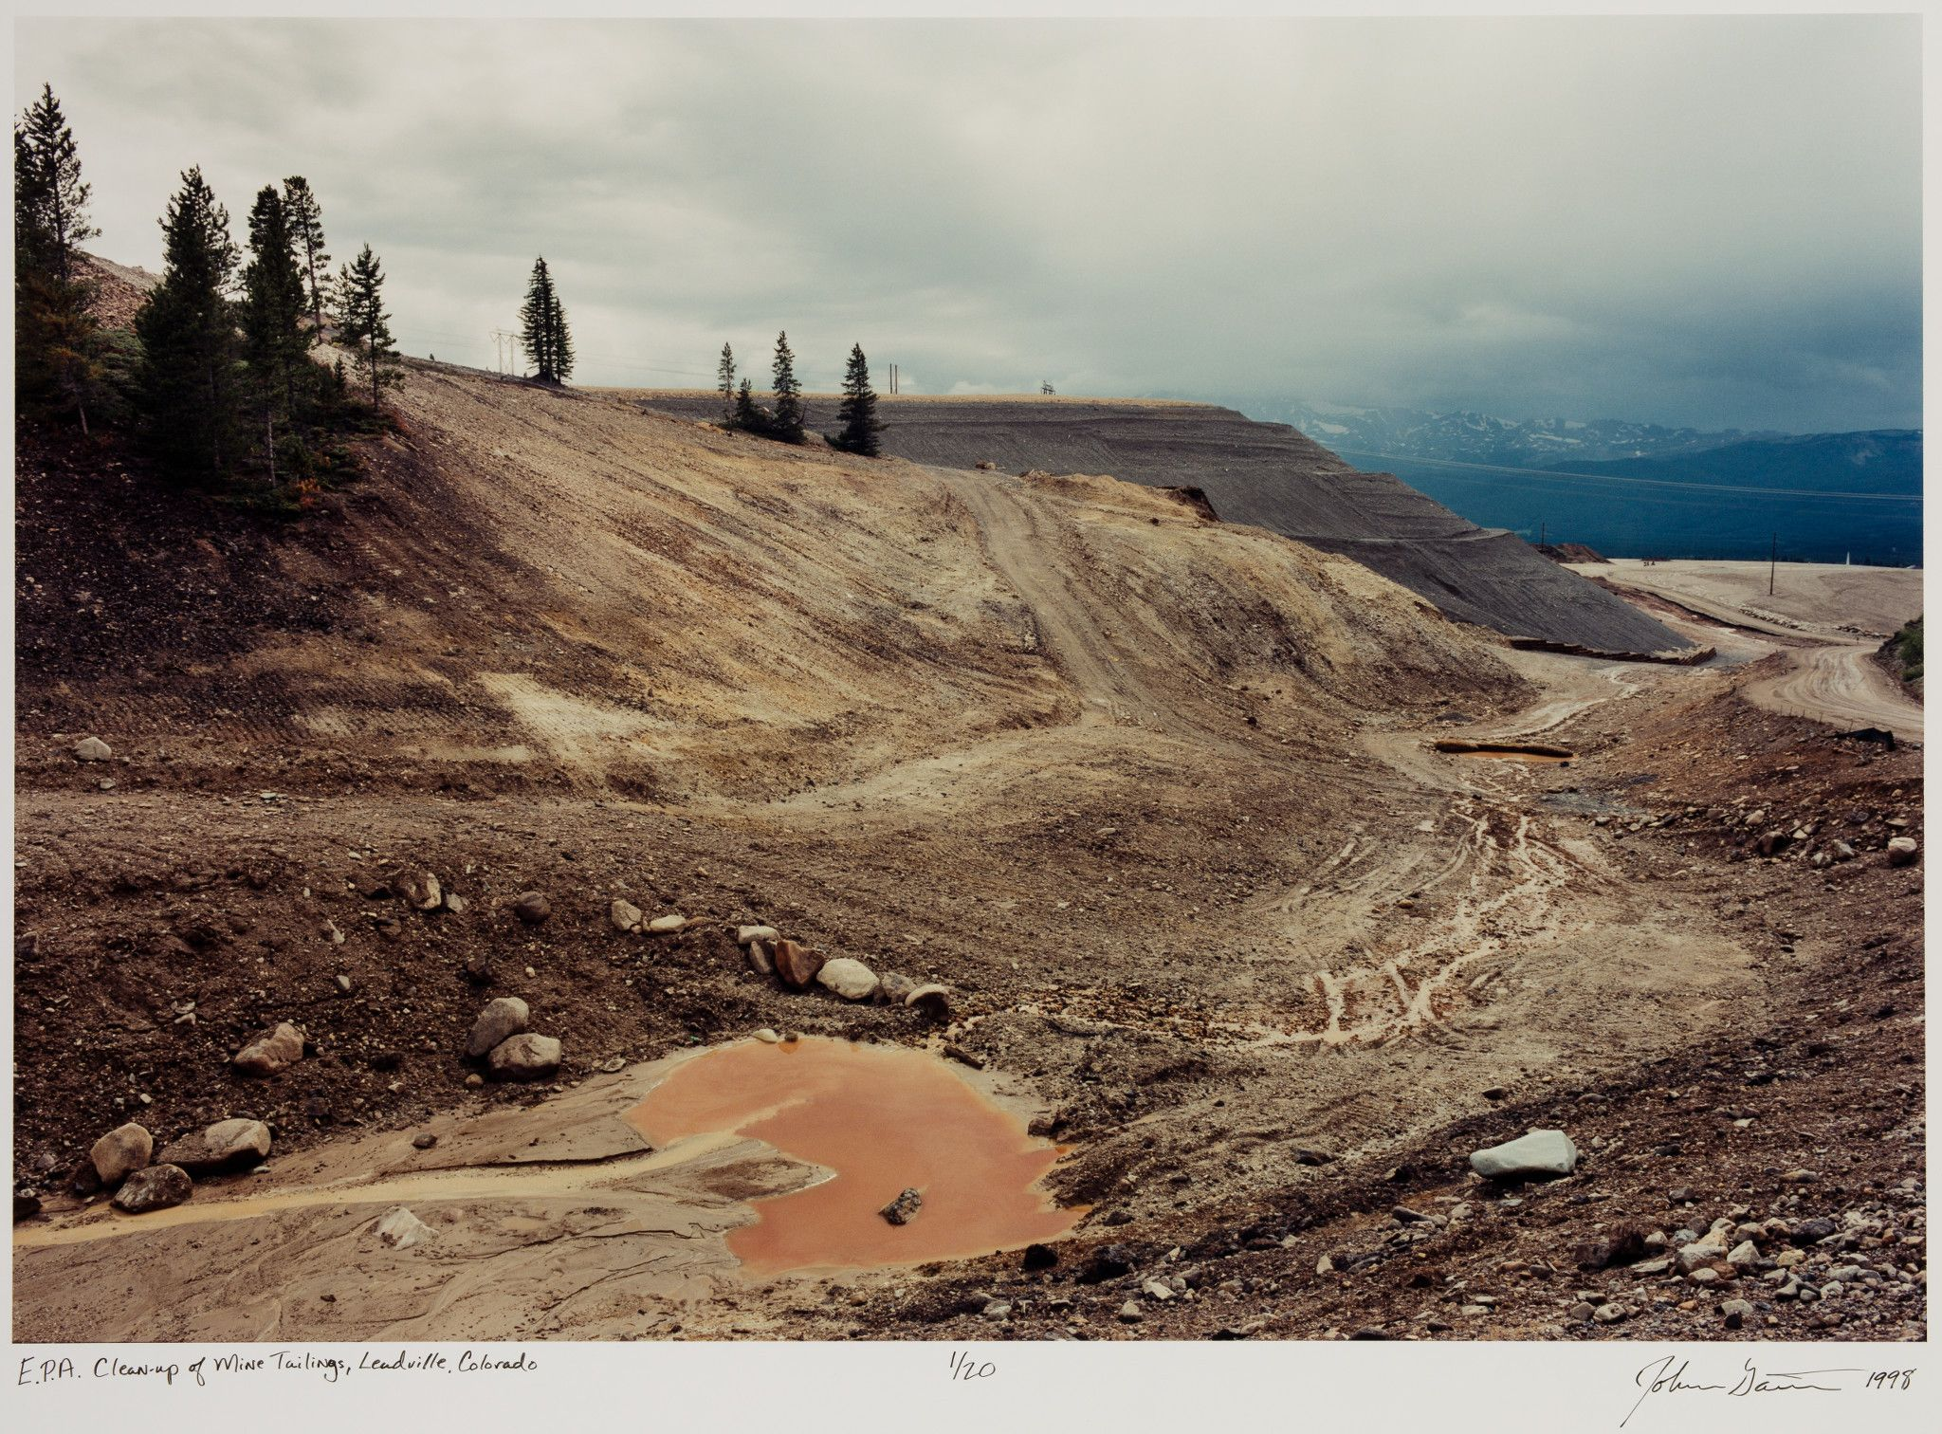
Case study: Alluvial Mine Tailings (Brown et al. 2009)
Location: Leadville, Colorado, USA.
Mining operations between the 1870s and 1980s created significant alluvial tailings contaminated with TEs. High water events transported contaminants in locations away from the source site such as the areas along the Arkansas river.
John Ganis, 1998. E.P.A Clean Up of Mine Tailings, Leadville, Colorado.

Slide 17
Case study: Alluvial Mine Tailings (Brown et al. 2009)
Remediation start: 1997
Native grasses (perennial ryegrass, annual ryegrass, and tufted hairgrass) were planted to remediate (stabilize) contaminants: Pb, Zn, Cd and acidity from historic mine tailings in the soil to a depth of about 0.3m.
Amendments:
Lime kiln (LKD),
Lime kiln + biosolids (LKD+BS),
Sugar beet lime + biosolids (SBL+BS),
Coarse lime + biosolids (CL+BS),
Ag lime + biosolids (AL+BS),
Fine lime + biosolids (FL+BS).

Slide 18
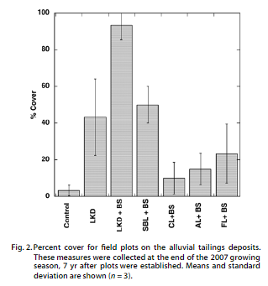
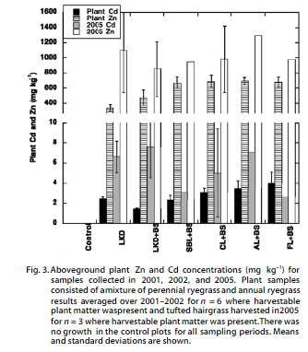
Case study: Alluvial Mine Tailings (Brown et al. 2009)
TEs availability and associated risks to humans and animals were reduced.

Slide 19
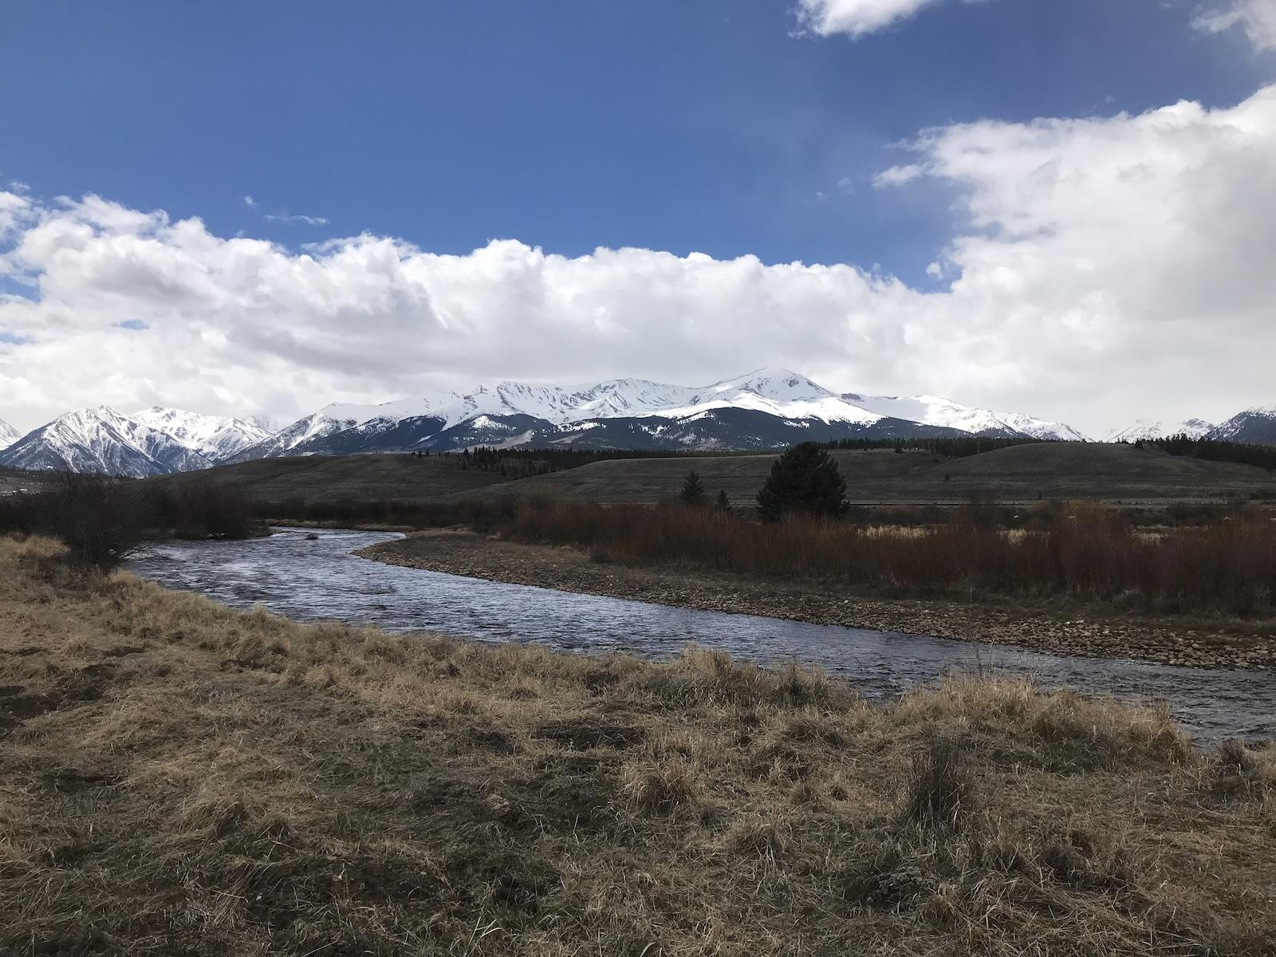
Case study: Alluvial Mine Tailings (Brown et al. 2009)
High Lonesome, one of the contaminated areas was successfully treated which is currently an access point for the public to the Arkansas River for trout fishing.
High Lonesome trail.
www.trailforks.com/trails/high-lonesome-trail/photos/

Slide 20
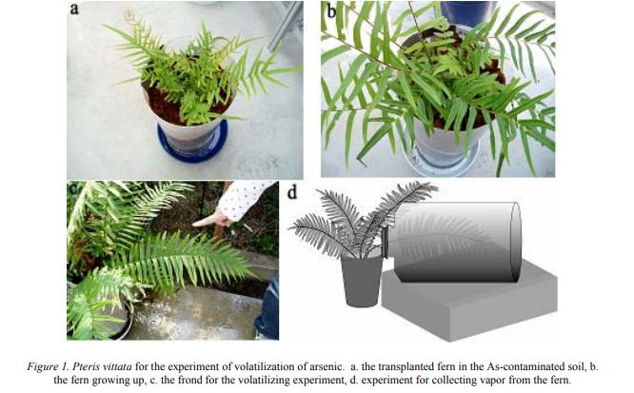
Phytovolatilization: Greenhouse experiment (Sakakibara et al. 2010)
It was determined that vapor released from the frond of P. vittata included arsenic compounds, arsenite and arsenate.
The results of experiment suggested that P. vittata effectively volatilizes As; it removed a maximum ratio of 90% of the total uptake of As from As-contaminated soils in greenhouse.

Slide 21
Case study: Spring Valley Formerly Used Defense Site (Van Slycken et al. 2013)
Location: Flanders region, Belgium.
From the end of the 19th century until mid 1970s, zinc and lead were refined in the area which was moderately contaminated with lead (Pb), zinc (Zn) and cadmium (Cd).
In 2004, Corn, rapeseed, willow and poplar were planted to extract TEs.
Willow and poplar species were grown using short rotation coppice systems and preliminary results showed that harvestable willow biomass far exceeds other species selected and will be best to achieve remediation goals.
The remediation is currently ongoing and it is estimated that it would take a minimum of 55 years to reduce the cadmium levels on site from 5 mg Cd/kg to safe levels of 2m Cd/kg.

Slide 22
References
Brown, S., Svendsen, A., Henry, C., 2009. Restoration of high zinc and lead tailings with municipal biosolids and lime: a field study. Journal of environmental quality, 38(6), pp.2189-2197.
Erickson, L.E. and Pidlisnyuk, V., 2021. Phytotechnology with Biomass Production: Sustainable Management of Contaminated Sites (p. 242). Taylor & Francis.
Indriolo, E., Na, G., Ellis, D., Salt, D.E. and Banks, J.A., 2010. A vacuolar arsenite transporter necessary for arsenic tolerance in the arsenic hyperaccumulating fern Pteris vittata is missing in flowering plants. The Plant Cell, 22(6), pp.2045-2057.
Kennen K., Kirkwood N., 2015. Phyto. Principles and resources for site remediation and landscape design. Routledge, Taylor & Francis Group.
Mishra, B., Varjani, S., Iragavarapu, G.P., Ngo, H.H., Guo, W. and Vishal, B., 2019. Microbial fingerprinting of potential biodegrading organisms. Current Pollution Reports, 5(4), pp.181-197.
Sakakibara, M., Watanabe, A., Inoue, M., Sano, S. and Kaise, T., 2010, January. Phytoextraction and phytovolatilization of arsenic from As-contaminated soils by Pteris vittata. In Proceedings of the annual international conference on soils, sediments, water and energy (Vol. 12, No. 1, p. 26).
Van Slycken, S., Witters, N., Meiresonne, L., Meers, E., Ruttens, A., Van Peteghem, P., Weyens, N., Tack, F.M. and Vangronsveld, J., 2013. Field evaluation of willow under short rotation coppice for phytomanagement of metal-polluted agricultural soils. International journal of phytoremediation, 15(7), pp.677-689.

