Slide 1
Phytoremediation of soils contaminated by organics.
BIOREMEDIATION AND PHYTOREMEDIATION

Slide 2
Content
Introduction
Phytotechnologies for organic contaminants
Principles of organic phytotechnologies
Experiments and case studies

Slide 3
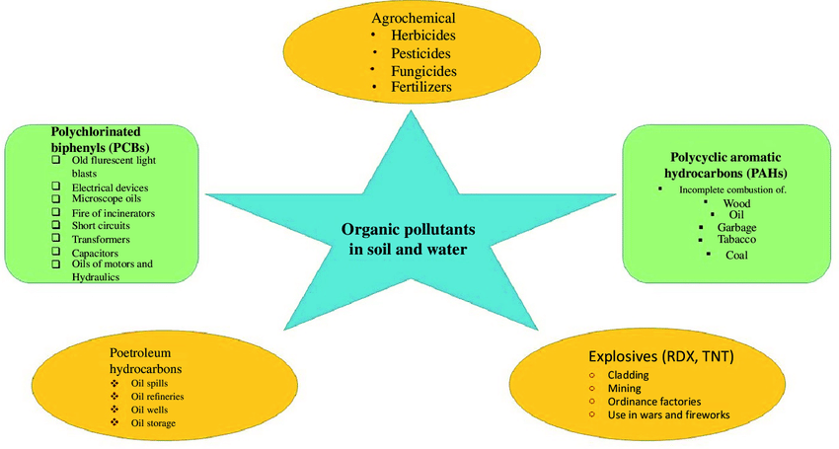
Introduction
Organic contaminants: Pollutant compounds that contain bonds of carbon, oxygen, and nitrogen, are man-made and foreign to living organisms.
Tanwir et al. 2021

Slide 4
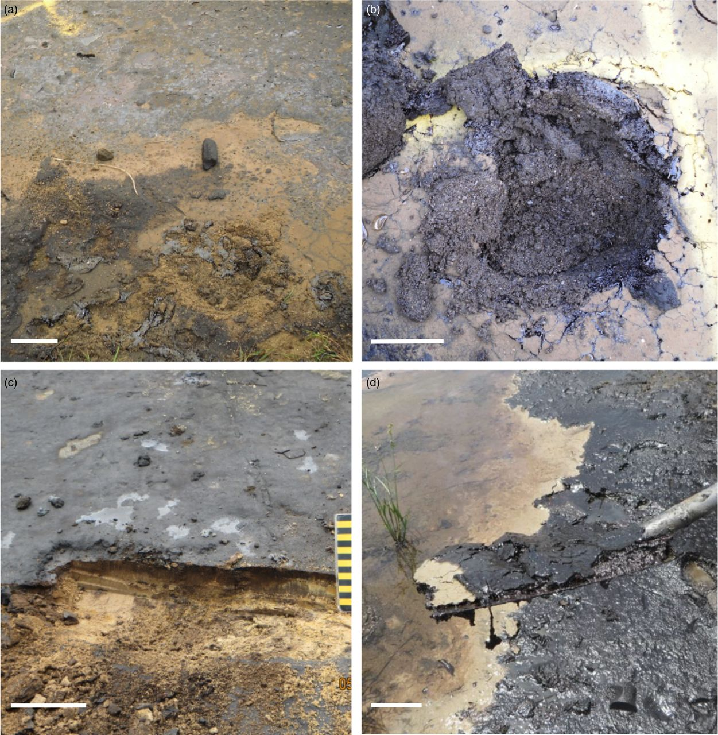
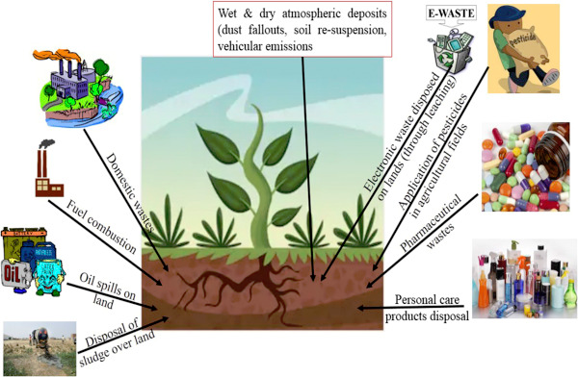
Brown et al. 2017
Gupta et al. 2020

Slide 5
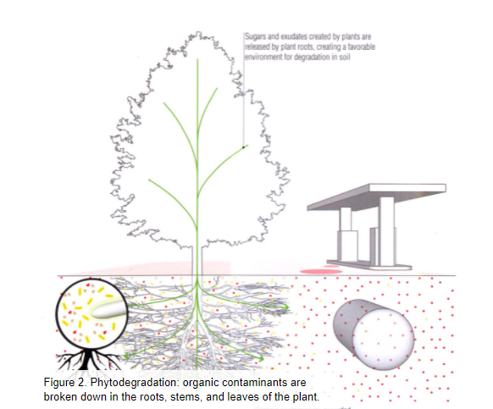
Phytotechnologies for organic contaminants
Since these contaminants are compounds, they may be degraded, breaking them down into smaller less toxic toxic components.
They may be degraded outside the plant in the root zone, taken into the plant, bound to the plant tissues, degraded to form non-toxic metabolites or released into the atmosphere.

Slide 6
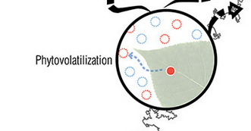
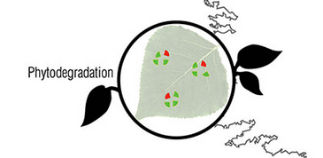
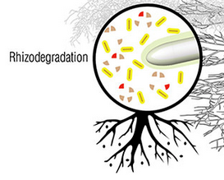
Phytotechnologies for organic contaminants
Kennen and Kirkwood (2015)

Slide 7
Principles of organic phytotechnologies
Octanol-water partition coefficient (Log Kow) :
This is a predictor to determine if an organic pollutant can be removed by plants. A lower log Kow indicates the pollutant will dissolve in water in the pore spaces between the soil particles allowing the plant system to access it for degradation.
Contaminants with a log Kow between 0.5 and 3.5 can likely be taken up and translocated into a plant for degradation, release into air or sequestration into plant parts unlike those with a log Kow value greater than 3.5.
High biomass-producing plants:
When plants have a higher growth rate, they can process and degrade contaminants faster than other species.
Fast growing plants may release more sugars at the root zone, creating an environment for enhanced degradation in the root zone.

Slide 8
Principles of organic phytotechnologies
High levels of oxygen-degrading enzymes and specific exudate compounds:
Species that release high levels of oxygen-degrading enzymes or specific root exudates are favorable for degrading organics as they can stimulate the growth of microbes involved in degradation.
Some enzymes can affect a pollutants water solubility, oxidation state, or other chemical factors that aid in degradation.
Phreatophytes:
Plants whose roots can survive both in aerobic and anaerobic conditions, e.g. willow, poplar, Prosopis glandulosa, etc. This feature enables a great diversity of microbes and reaction
Vaporization of pollutants:
Some pollutants can be released into the atmosphere after they are taken up by the plants. Pollutants that vaporize can be identified by the dimensionless Henry’s law constant (Hi). If Hi ˃ 10^-3 for any pollutant then it can volatize through the plant into the air.

Slide 9
Phytoremediation of Organics at field scale
Common organic pollutants successfully degraded at field scale
Common organic pollutants not successfully degraded at field scale

Slide 10
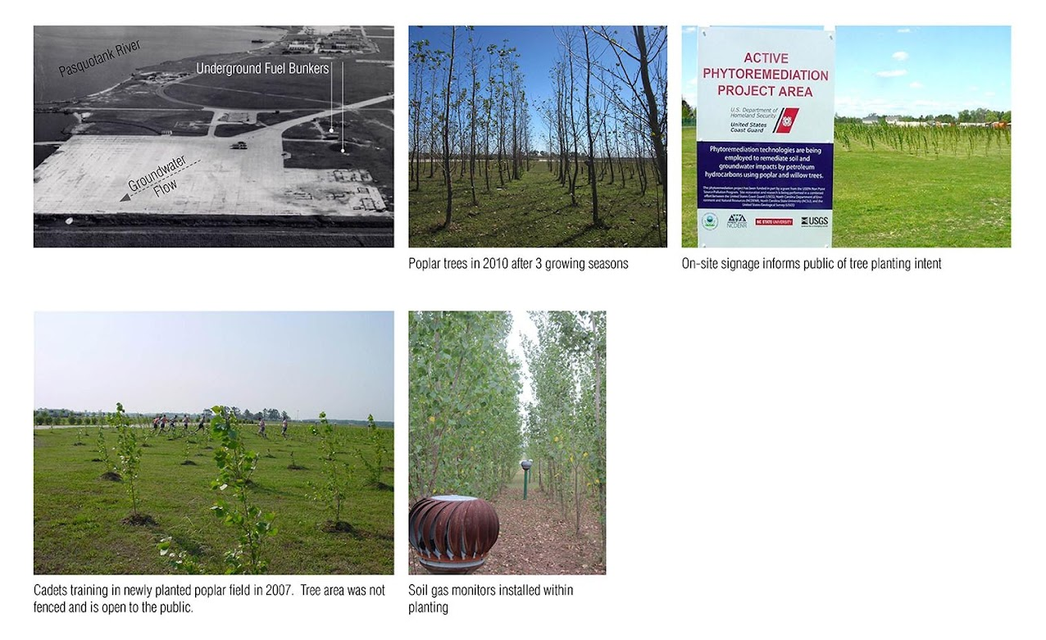
Case study: US Coast Guard former fuel storage facility (Kennan and Kirkwood 2015)
Contaminants: BTEX, TPH, MTBE and PAH.
Plants established: Hybrid poplar, Willow and Loblolly Pine.
Established between 2006-2007.

Slide 11
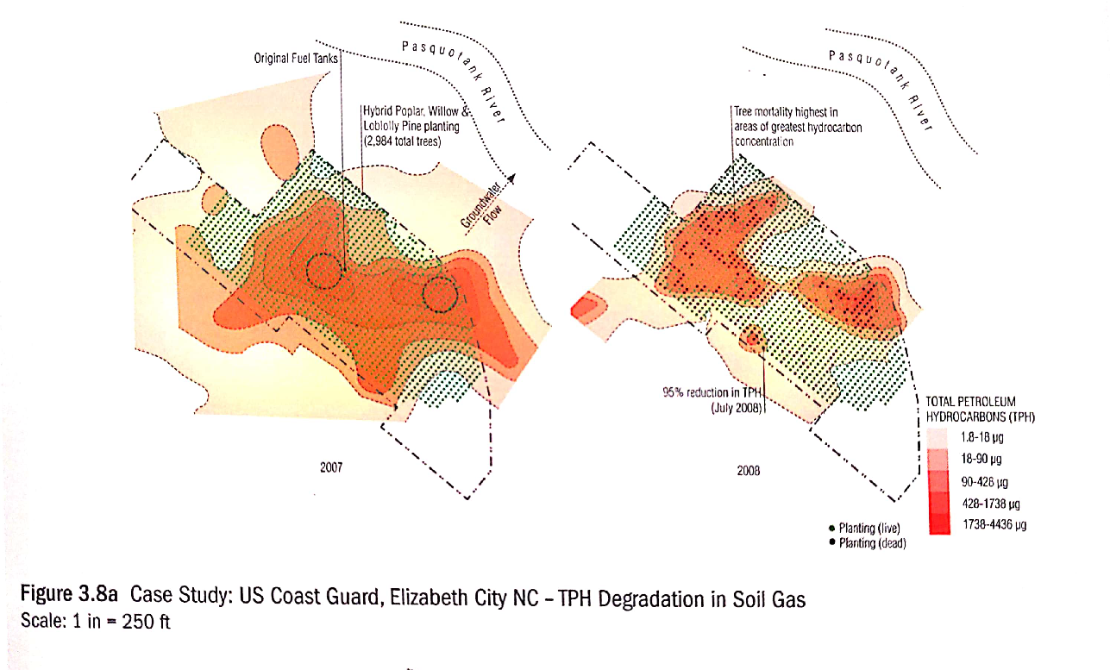

Slide 12
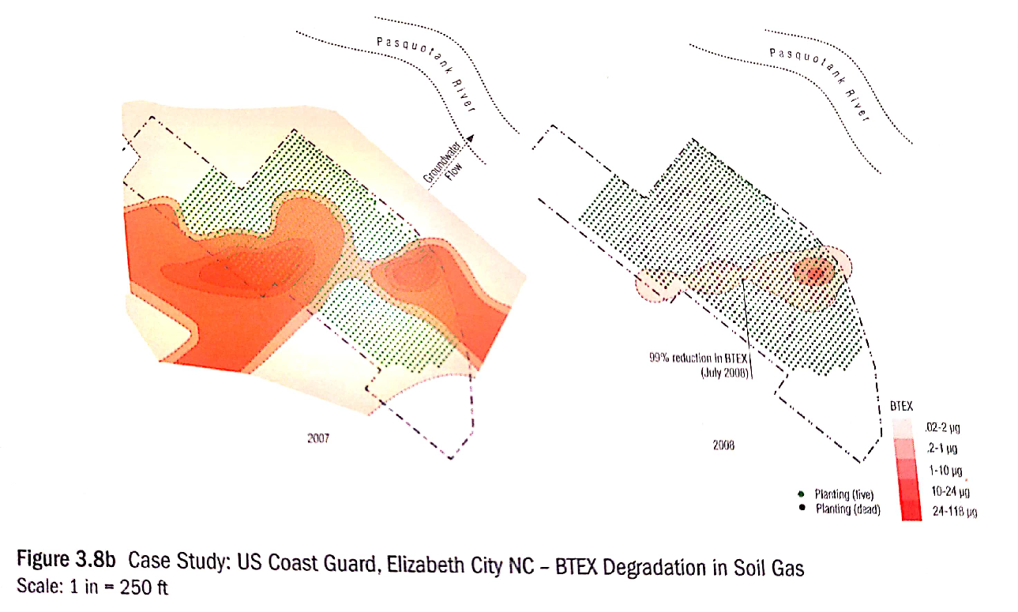

Slide 13
Experiment: Remediation of pesticides (Mamirova et al. 2020)
Using Miscanthus sinensis to remediate soil polluted with pesticides in a pot experiment.
The introduction of soil amendments improved the growth parameters of M. sinensis.
The addition of Tween 20 enhanced the absorption and transmigration to aboveground biomass.
The effect was due to the reduction of the hydrophobicity which made pesticides more bioavailable for the plant.

Slide 14
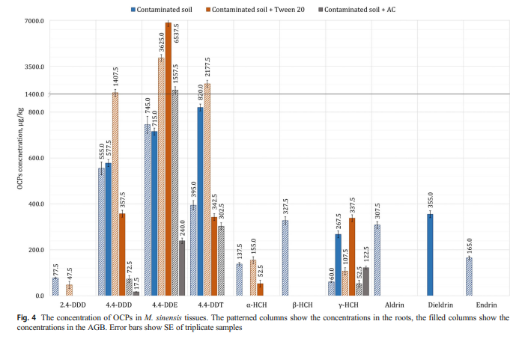

Slide 15
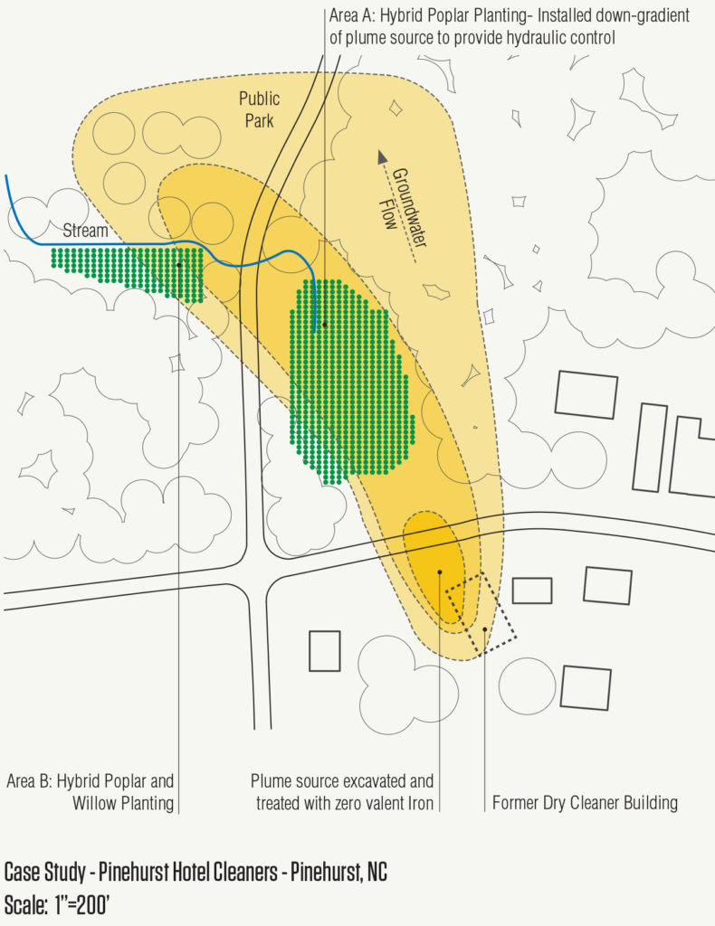
Case study: Pinehurst Hotel Dry Cleaners
Pinehurst Hotel Cleaners was a dry cleaning and laundry facility for the former Pinehurst Hotel and operated from the 1930’s until the 1970’s.
Contamination was identified during a due diligence assessment on an adjacent property.
https://www.offshootsinc.com/2018/11/05/case-study-pinehurst-hotel-dry-cleaners/

Slide 16
Case study: Pinehurst Hotel Dry Cleaners
Beginning in 2008, 750 tons of contaminated soil were excavated at the plume source and treated on site using a mobile steam distillation unit. Additionally, zero valent iron was added near the plume source to help breakdown contaminants.
Between 2008 - 2010, hybrid poplars and willows were planted with iron (zero valent) amendment in soil and groundwater contaminated with chlorinated hydrocarbons: PCE and TCE, and petroleum contaminant: Benzene and Xylenes.
The phytotechnology plantings provided hydraulic control of the contaminated plume discharged by the dry cleaning and prevented discharge of dry-cleaning solvents to a nearby surface-water stream.

Slide 17
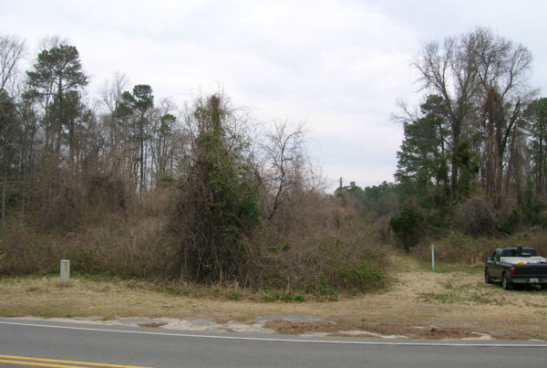
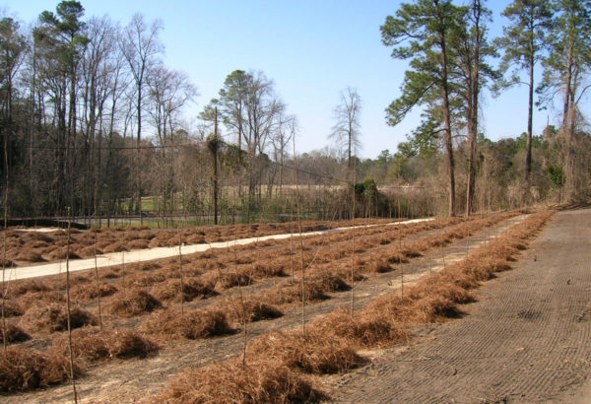
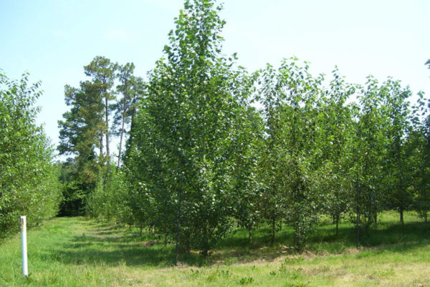
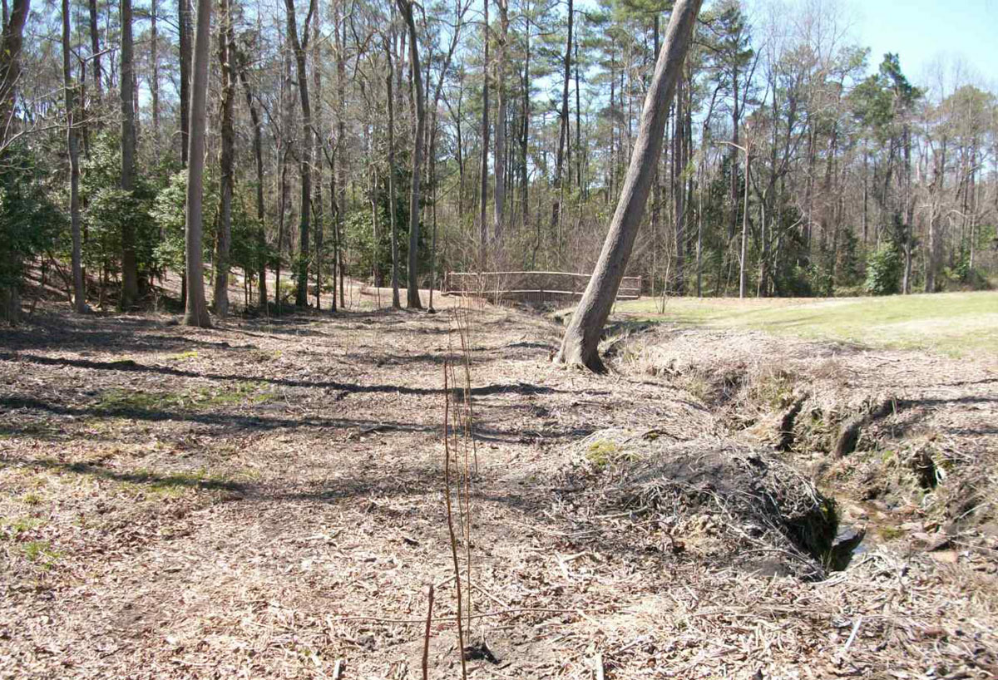
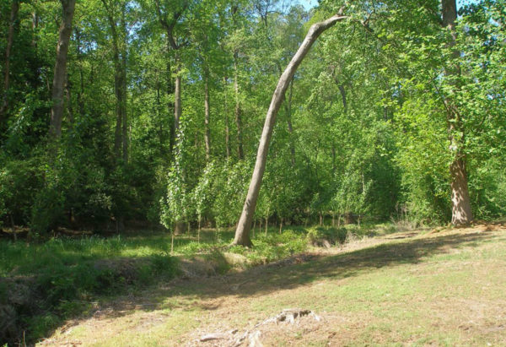
Area before phytoremediation
Installation of popular: 2008
Phytoremediation Area A- 2010- 2.5 years of growth
Phytoremediation Area B- Original Installation- Poplars and Willows were installed to protect the surface water swale visible on the right from contaminated groundwater
Phytoremediation Area B- 2010- 2.5 years of growth

Slide 18
References
Brown, D.M., Bonte, M., Gill, R., Dawick, J. and Boogaard, P.J., 2017. Heavy hydrocarbon fate and transport in the environment. Quarterly Journal of Engineering Geology and Hydrogeology, 50(3), pp.333-346.
Gupta, A., Patel, A.K., Gupta, D., Singh, G. and Mishra, V.K., 2020. Rhizospheric remediation of organic pollutants from the soil; a green and sustainable technology for soil clean up. In Abatement of Environmental Pollutants (pp. 263-286). Elsevier.
Kennen K., Kirkwood N., 2015. Phyto. Principles and resources for site remediation and landscape design. Routledge, Taylor & Francis Group.
Tanwir, K., Javed, M.T., Shahid, M., Akram, M.S. and Ali, Q., 2021. Antioxidant defense systems in bioremediation of organic pollutants. In Handbook of Bioremediation (pp. 505-521). Academic Press.

