Slide 1
Phytotechnologies to clean up contaminated sites
Dr. Karim Suhail Al Souki, PhD

Slide 2
Pollution and their consequences
  When harmful substances contaminate the natural environment it is called Pollution.
  Intense industrial and agricultural activities worldwide.
  Pollutants such as Heavy metals (Hg and Ni), Petroleum hydrocarbons and pesticides.
Consequences
Disturbs ecosystem
Global Warming
Human health
Infertile lands

Slide 3
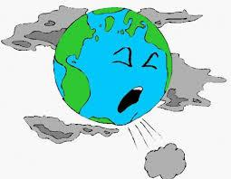
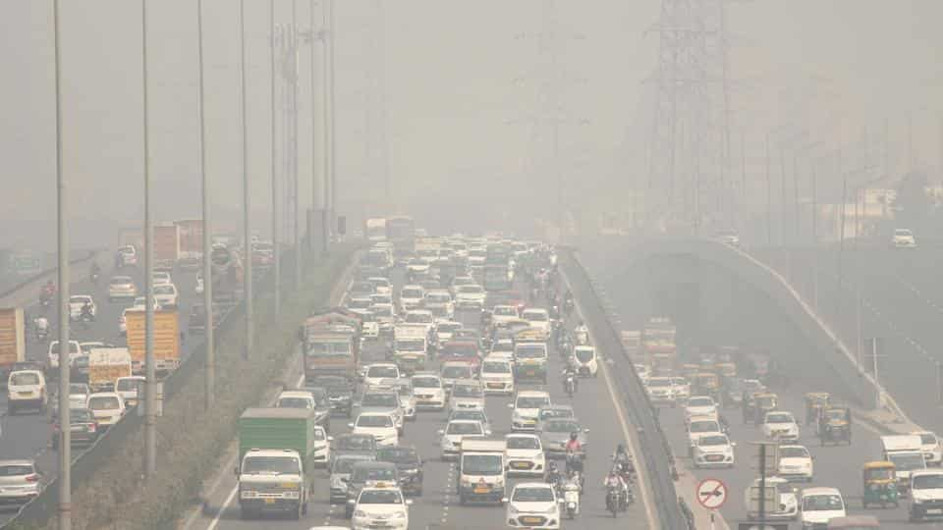
Environmental (Air, Water and Soil/Land) Pollution
Air pollution: Caused by exhausts to the atmosphere from airplanes, vehicles and industrial plants; open burning; gaseous (e.g. methane) releases from open dumps etc. Since our atmosphere is universal, it can be concluded that the earth's air medium is universally contaminated, albeit, to varying degrees.

Slide 4
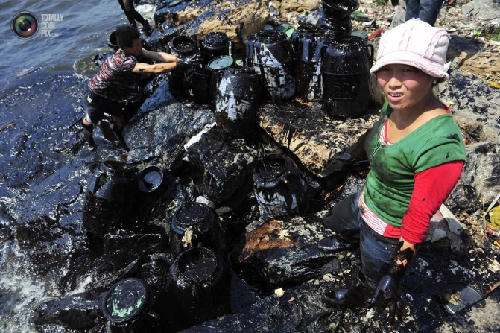
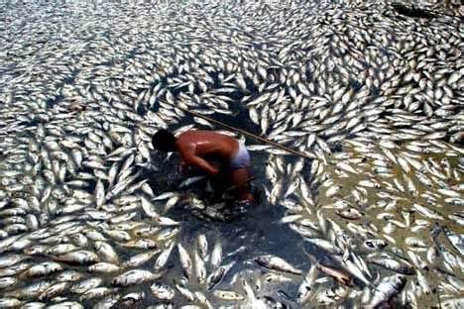
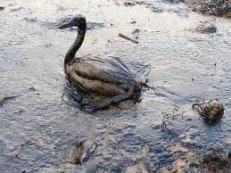
Water pollution: - Most of our water bodies have been impacted through our water transportation activities; heavy oil spills and leaks to water bodies, direct deposition of wastes to water bodies and contamination through seepages from landfill or dump sites.

Slide 5
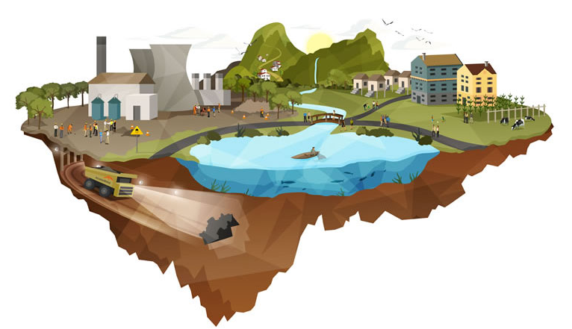
Land pollution: - Lands used for industrial activities (gas stations, manufacturing factories, etc) are left contaminated after use. Several releases of chemicals, oil and other substances to the land. Contaminated sites abound everywhere in major locations of the world. Besides the chemicals released on the contaminated lands, several debris and wastes that constitute dangers are left on the sites.

Slide 6
CONTAMINANTS OF CONCERNS
The contaminants of concerns on used sites depend on the previous activities (industrial, commercial or domestic) that took place at the site. The contaminants released to a site that was used as a gas station will be different from those released into a site where mining activities or ore processing took place.
The broad category of contaminants that could be found on most contaminated sites include:
Dilapidating Infrastructure - buildings, equipments, and other structures
Hazardous chemicals/wastes
Surface Debris / non-hazardous wastes
Contaminated Soils - metals impacted soils; petroleum hydrocarbon (PHC) impacted soils or polychlorinated biphenyl (PCB) impacted soils
Mine openings - adits, vent raises, shafts, exploration ditches/trenches

Slide 7
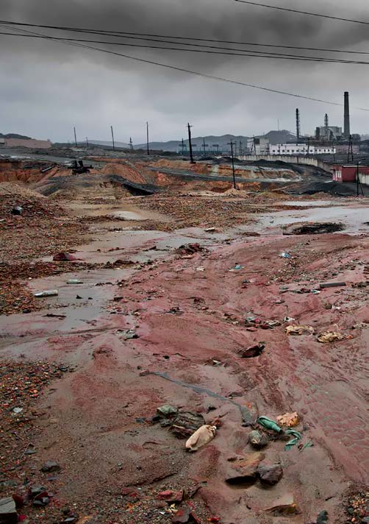
Soil Pollution
“Soil pollution” refers to the presence in the soil of a chemical or substance out of place and/or present at a higher than normal concentration that has adverse effects on any non-targeted organism (FAO and ITPS, 2015).
Soil pollution often cannot be directly assessed or visually perceived, making it a hidden danger.

Slide 8
The main sources of soil pollution are anthropogenic, resulting in the accumulation of contaminants in soils that may reach levels of concern.
Industrial activities including mining, smelting and manufacturing; domestic, livestock and municipal wastes; pesticides, herbicides, fertilizers used in agriculture; petroleum-derived products that are released into or break-down in the environment; fumes generated by transportation — all contribute to the problem.
So-called "emerging pollutants" are also a growing concern. These include pharmaceuticals, endocrine disruptors, hormones and biological pollutants; "e-waste" from old electronics; and the plastics that are nowadays used in almost every human endeavour.
The presence of certain pollutants may also produce nutrient imbalances and soil acidification, two major issues in many parts of the world.

Slide 9
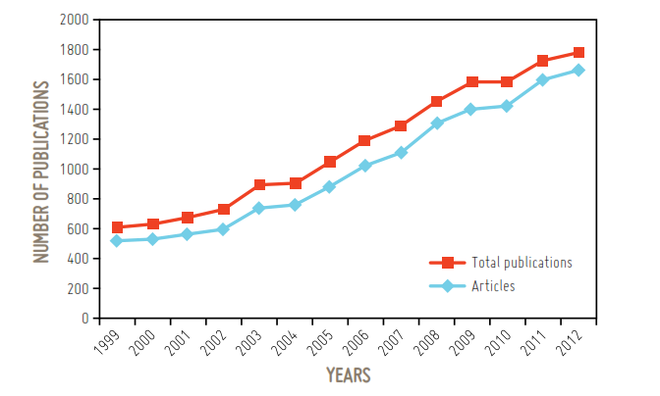
Fortunately, awareness on the importance of soil pollution is increasing around the world, leading to an increase in research conducted on the assessment and remediation of soil pollution.
Number of scientific publications on soil pollution in the period of 1999-2012. Source: Guo et al., 2014

Slide 10
Soil pollution can result from both intended and unintended activities.
These activities can include the direct deposition of contaminants into the soil as well as complex environmental processes that can lead to indirect soil contamination through water or atmospheric deposition.
Different types of soil pollution
POINT-SOURCE POLLUTION
DIFFUSE POLLUTION

Slide 11
POINT-SOURCE POLLUTION
Soil pollution can be caused by a specific event or a series of events within a particular area in which contaminants are released to the soil, and the source and identity of the pollution is easily identified. This type of pollution is known
as point-source pollution.
Anthropogenic activities represent the main sources of point-source pollution.
Examples include former factory sites, inadequate waste and wastewater disposal, uncontrolled landfills, excessive application of agrochemicals, spills of many types, and many others.
Activities such as mining and smelting that are carried out using poor environmental standards are also sources of contamination with heavy metals in many regions of the world.

Slide 12
Other examples of point-source pollution are aromatic hydrocarbons and toxic
metals, which are related to oil products.
    The sites range from leakage from tank installations in Greenland, which caused aromatic hydrocarbon and toxic metal levels that exceeded the Danish environmental quality criteria (Fritt-Rasmussen et al., 2012), to accidental leakage from oil refinery storage tanks in Tehran (Bayat et al., 2016).
Point-source pollution is very common in urban areas.
    Soils near roads have high levels of heavy metals, polycyclic aromatic hydrocarbons, and other pollutants.
    Old or illegal landfills, where waste is not disposed of properly or according to its toxicity (e.g. batteries or radioactive waste), as well as disposal of sewage sludge and wastewater, can also be important point-source pollutants.

Slide 13
DIFFUSE POLLUTION
Diffuse pollution is pollution that is spread over very wide areas, accumulates in soil, and does not have a single or easily identified source. Diffuse pollution occurs where emission, transformation and dilution of contaminants in other media have occurred prior to their transfer to soil.
Diffuse pollution involves the transport of pollutants via air-soil-water systems.
Complex analyses involving these three compartments is therefore needed in order adequately to assess this type of pollution. For that reason, diffuse pollution is difficult to analyze, and it can be challenging to track and to delimit its spatial extent.
Many of the contaminants that cause local pollution may be involved in diffuse pollution, since their fate in the environment is not well understood.

Slide 14
Examples of diffuse pollution are numerous and can include sources from
  nuclear power and weapons activities;
  uncontrolled waste disposal and contaminated effluents released in and near catchments; land application of sewage sludge;
  the agricultural use of pesticides and fertilizers which also add heavy metals, persistent organic pollutants, excess nutrients and agrochemicals that are transported downstream by surface runoff;
  flood events;
  atmospheric transport and deposition; and/or soil erosion.
Diffuse pollution has a significant impact on the environment and human health, although its severity and extent are generally unknown.

Slide 15
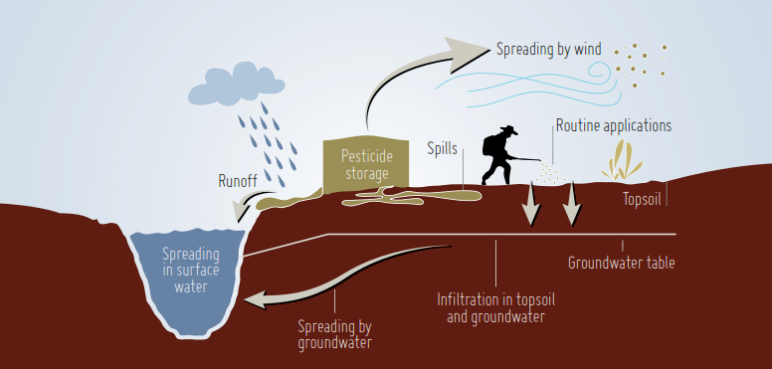
Fig. Transport pathway of pesticides in the environment. Source: FAO, 2000

Slide 16
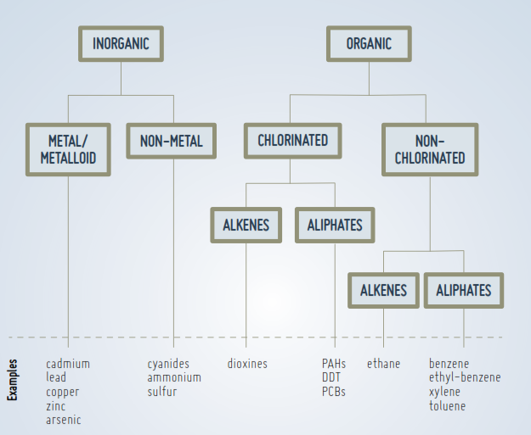
MAIN POLLUTANTS IN SOIL

Slide 17
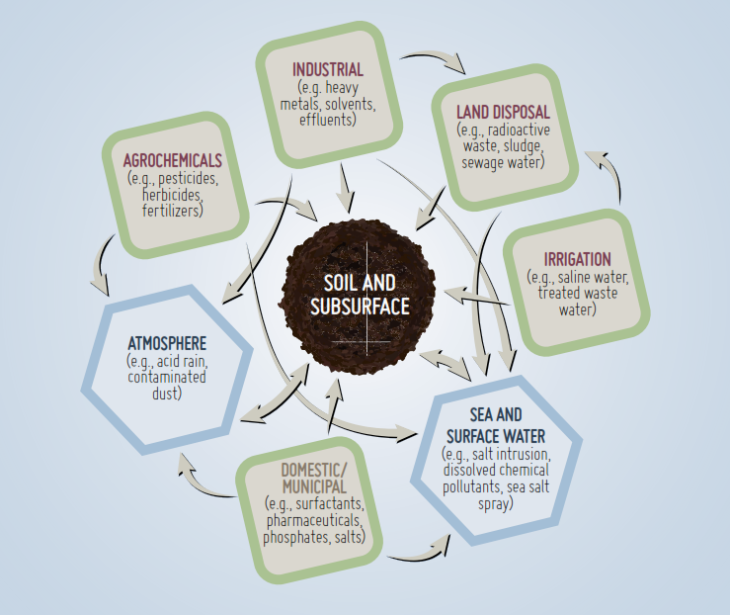
2. ANTHROPOGENIC SOURCES
Centuries of anthropogenic activities have resulted in a widespread problem of soil pollution around the world.
Fig. Potential interrelated pathways for soil-subsurface chemical contamination.

Slide 18
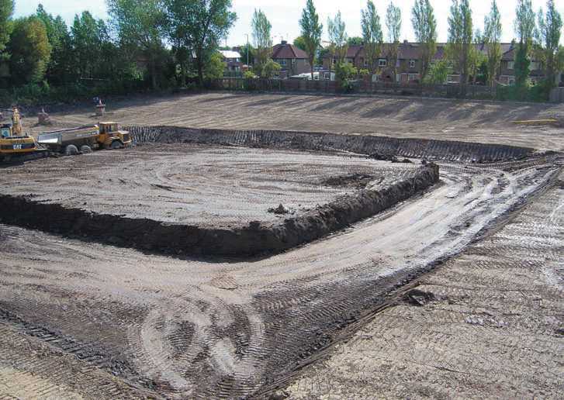
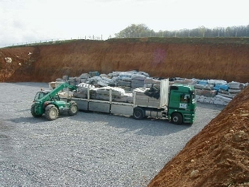
Remediation techniques
Physico-chemical techniques
  Remove and transport to landfill / pump and treat type systems
Notes:
18
18

Slide 19
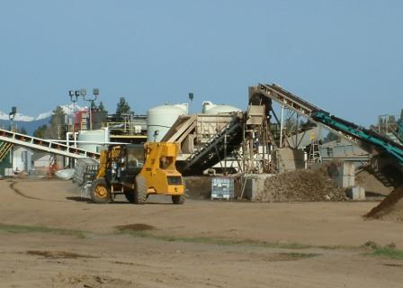
Remediation techniques
Physico-chemical techniques
  Excavation and landfill
  Soil washing
Notes:
19
19

Slide 20
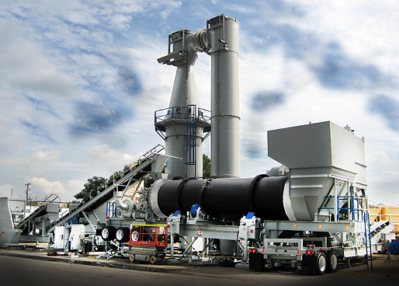
Remediation techniques
Physico-chemical techniques
  Excavation and landfill
  Soil washing
  Thermal treatment
Notes:
20
20

Slide 21
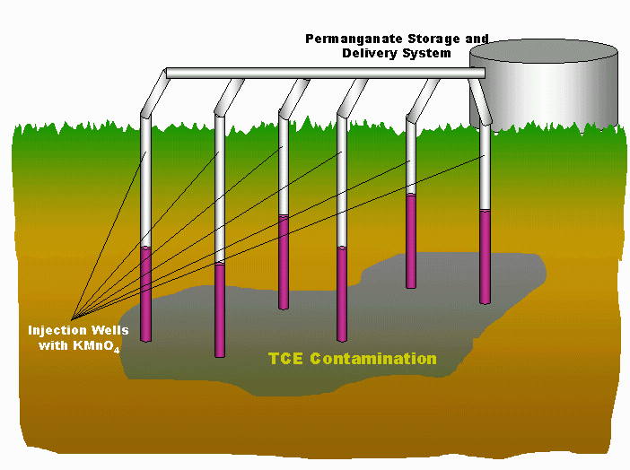
Remediation techniques
Physico-chemical techniques
  Excavation and landfill
  Soil washing
  Thermal treatment
  Oxidation
Notes:
21
21

Slide 22
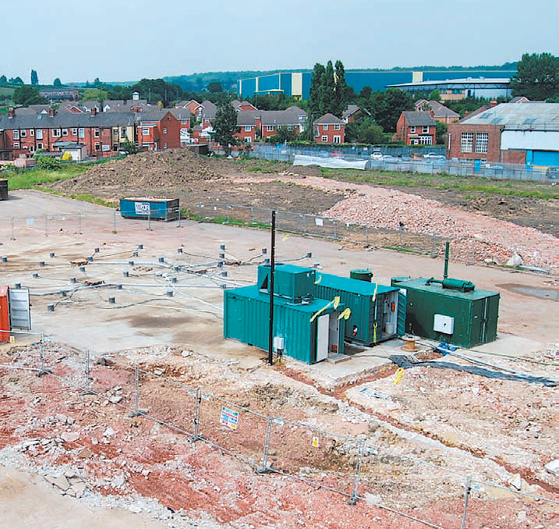
Remediation techniques
Physico-chemical techniques
  Excavation and landfill
  Soil washing
  Thermal treatment
  Oxidation
  Venting
Notes:
22
22

Slide 23
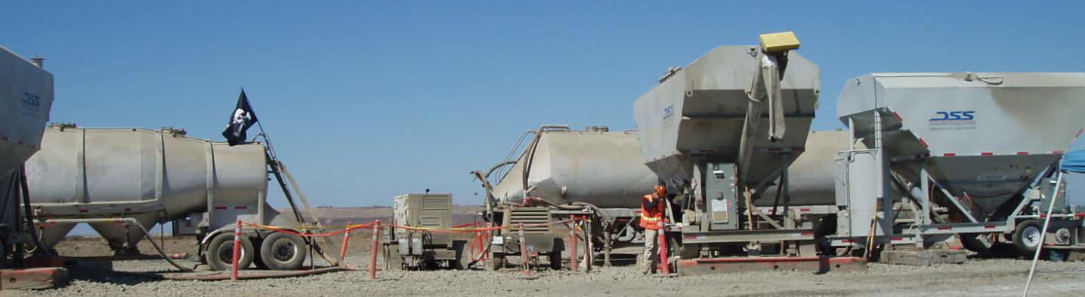
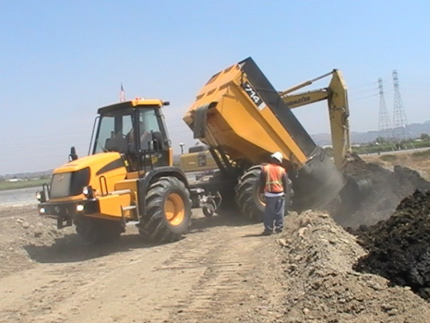
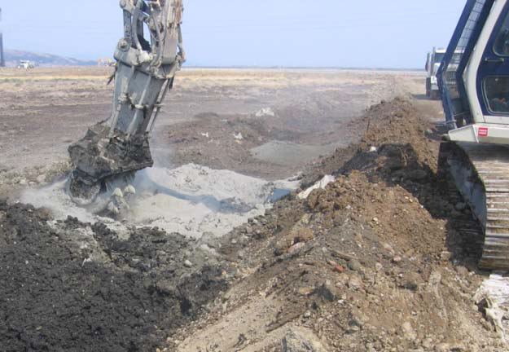
Remediation techniques
Physico-chemical techniques
  Excavation and landfill
  Soil washing
  Thermal treatment
  Oxidation
  Venting
  Solidification / stabilisation
Notes:
23
23

Slide 24
Remediation techniques
Physico-chemical techniques
  Excavation and landfill
  Soil washing
  Thermal treatment
  Oxidation
  Venting
  Solidification / stabilisation
  Vitrification
Notes:
24
24

Slide 25
Remediation techniques
Physico-chemical techniques
  Excavation and landfill
  Soil washing
  Thermal treatment
  Oxidation
  Venting
  Solidification / stabilisation
  Vitrification
  …
Fast and efficient
Treat concentrate pollution on « small » sites
Easy to plan
Some of the techniques do not require technical skills
Organisation
Money and energy cost
Environmental unfriendly
« Rude » techniques : some of them sterilize the soils: future use?
Noise and olfactory nuisance
Notes:
25
25

Slide 26
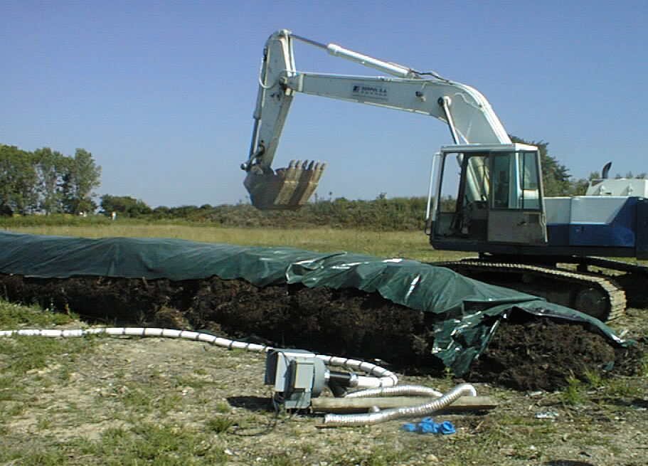
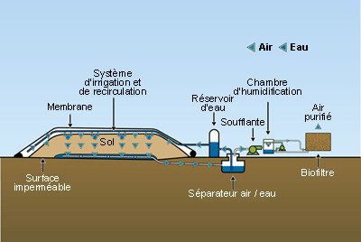
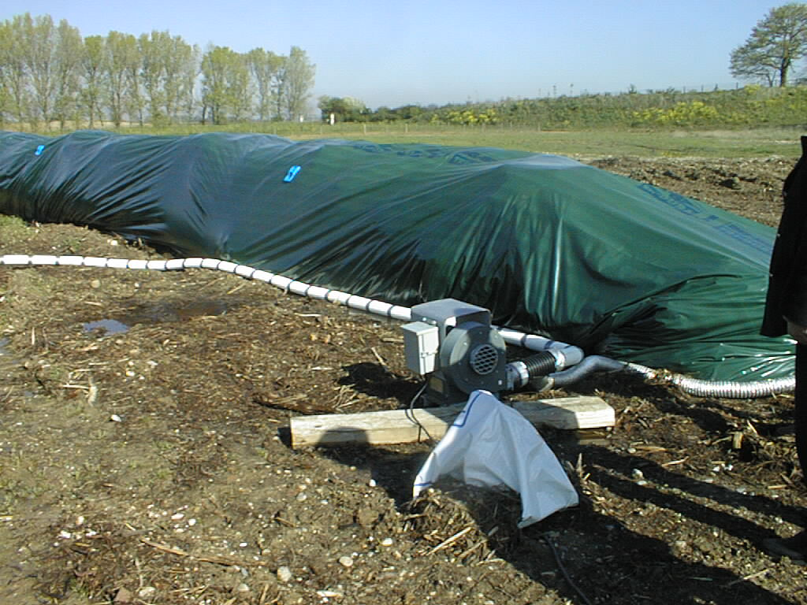
Remediation techniques: bioremediation
Bioremediation is the use of micro-organisms (generally bacteria) in various engineered treatment options to clean-up polluted matrices (soil, water, sediments)
  Natural attenuation
  Bioaugmentation
  Biopile
Notes:
26
26

Slide 27
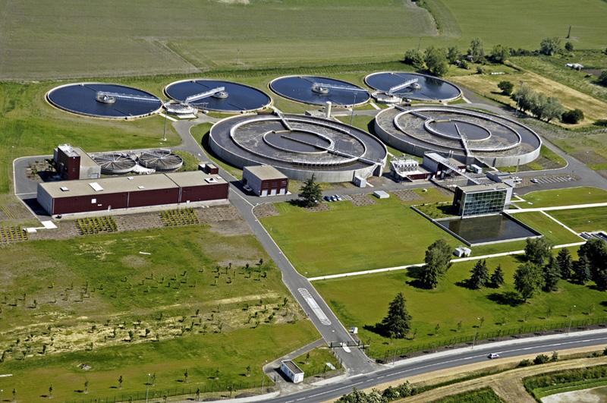
Remediation techniques: bioremediation
Bioremediation is the use of micro-organisms (generally bacteria) in various engineered treatment options to clean-up polluted matrices (soil, water, sediments)
  Natural attenuation
  Bioaugmentation
  Biopile
Notes:
27
27

Slide 28
Remediation techniques: bioremediation
Bioremediation is the use of micro-organisms (generally bacteria) in various engineered treatment options to clean-up polluted matrices (soil, water, sediments)
  Natural attenuation
  Bioaugmentation
  Biopile
Cheap (2 to 20 times cheaper than conventional methods)
Could be quite fast and efficient
Do not require high technical skills
Cannot deal with MTE and huge pollution
Logistics
Cost and energy cost (ex situ, on site)
Soil destructuration
Extensive
Duration of remediation?
Notes:
28
28

Slide 29
Remediation techniques: phytoremediation
Phytoremediation is the use of plants and their associated micro-organisms in various engineered treatment options to clean-up polluted matrices (soil, water, sediments)
What is phytoremediation?
Notes:
29
29

Slide 30
Remediation techniques: phytoremediation
Phytoremediation is the use of plants and their associated micro-organisms in various engineered treatment options to clean-up polluted matrices (soil, water, sediments)
What are the phytoremediation techniques?
Notes:
30
30

Slide 31
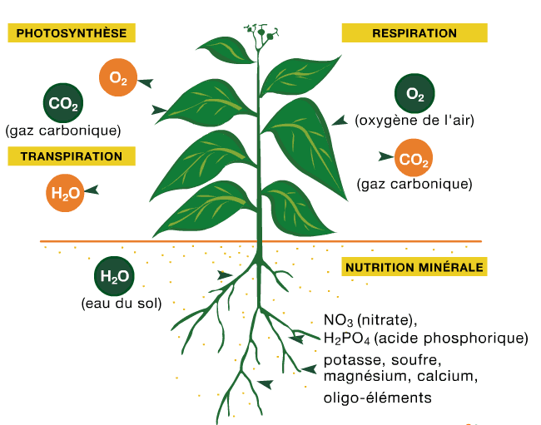
Remediation techniques: phytoremediation
Phytoremediation is the use of plants and their associated micro-organisms in various engineered treatment options to clean-up polluted matrices (soil, water, sediments)
- Phytoextraction
31
Notes:
31
31

Slide 32
Remediation techniques: phytoremediation
Phytoremediation is the use of plants and their associated micro-organisms in various engineered treatment options to clean-up polluted matrices (soil, water, sediments)
- Phytoextraction
- Phytostabilization
32
Notes:
32
32

Slide 33
Remediation techniques: phytoremediation
Phytoremediation is the use of plants and their associated micro-organisms in various engineered treatment options to clean-up polluted matrices (soil, water, sediments)
- Phytoextraction
- Phytostabilization
- Phytotransformation or phytodegradation
+
33
Notes:
33
33

Slide 34
Remediation techniques: phytoremediation
Phytoremediation is the use of plants and their associated micro-organisms in various engineered treatment options to clean-up polluted matrices (soil, water, sediments)
- Phytoextraction
- Phytostabilization
- Phytotransformation or phytodegradation
- Phytovolatilisation
- Rhizofiltration
+
34
Notes:
34
34

Slide 35
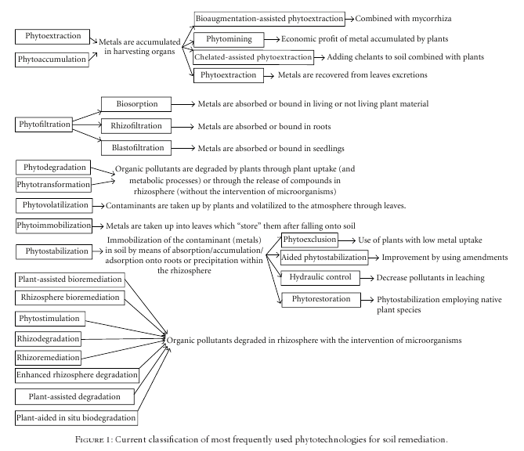
Remediation techniques: phytoremediation
Conesa et al., 2012
Notes:
35
35

Slide 36
Remediation techniques: phytoremediation
Phytoremediation is the use of plants and their associated micro-organisms in various engineered treatment options to clean-up polluted matrices (soil, water, sediments)
Phytoremediation market is growing… but is still confidential (1% in USA, 0.3% in France)!
Wetlands were used for waste treatment in Europe for centuries
Last century: metal hyperaccumulator plants were discovered and used as indicators for mining
1994: First use of the term « phytoremediation »
Hundreds/thousands of greenhouse experiments… but less than 100 experimental sites worldwide!!! (In 2010: Europe: 40 for phytostabilisation, 30 for phytoextraction; Worldwide: <15 for phytodegradation)
Notes:
36
36

Slide 37
Remediation techniques: phytoremediation
Phytoremediation techniques: pros and cons?
Notes:
37
37

Slide 38
Remediation techniques: phytoremediation
Phytoremediation: pros
Cost effective (10 to 100 times cheaper than conventional methods)
Low energy cost (sun!)
Low technical skills
Environmental friendly
“nature” method, more esthetically pleasing
Good public acceptance
Reduces potential for transport of contaminants by wind, reduces soil erosion
Multiple contaminants can be removed with the same plant
Minimal land disturbance.
Maintain / stimulate soil biodiversity and/or functionnality
No noise and olfactory nuisance
Notes:
38
38

Slide 39
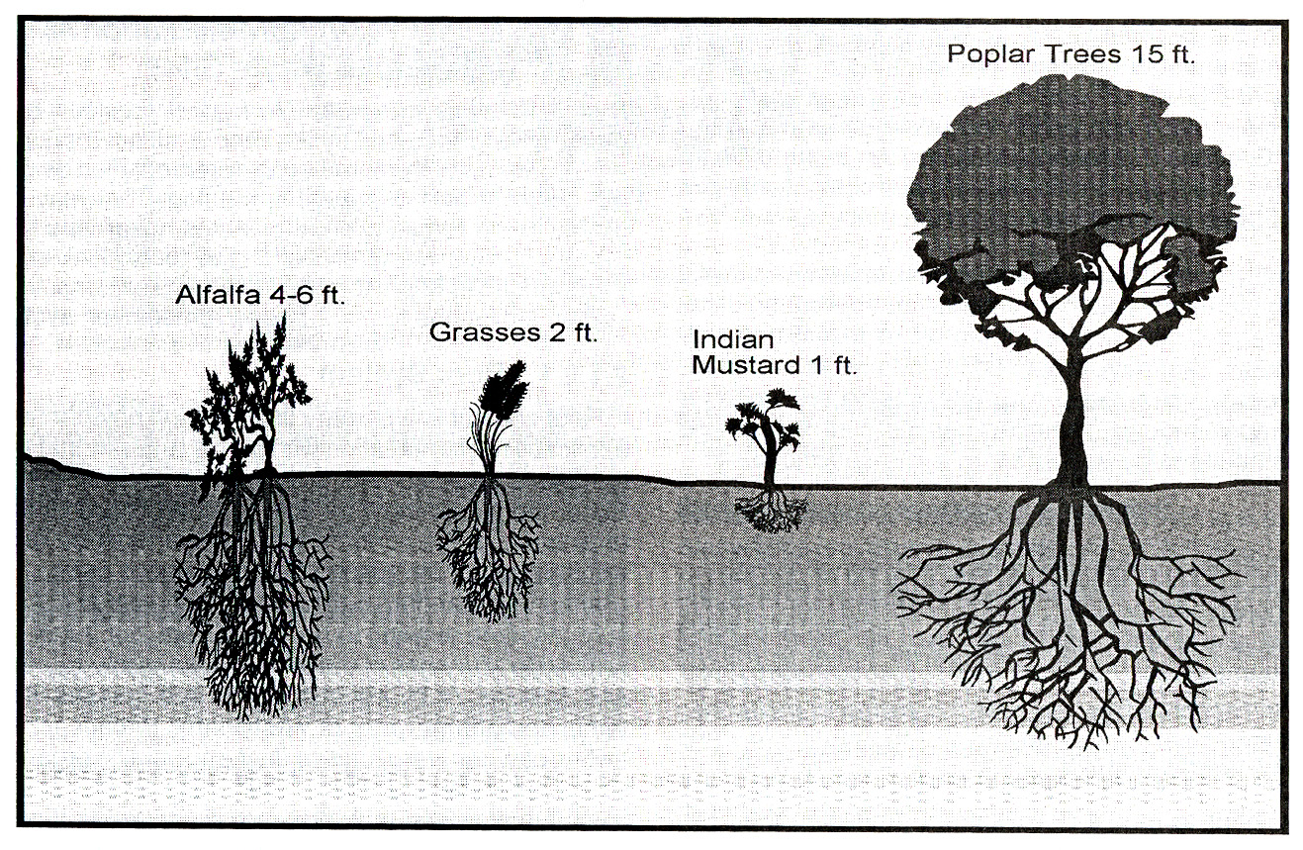
Remediation techniques: phytoremediation
Phytoremediation: cons
Slow rate : several years to several tens of years
Difficult to achieve acceptable levels of remediation
Extensive
Limited to root depth
Notes:
39
39

Slide 40
Remediation techniques: phytoremediation
Phytoremediation: cons
Slow rate : several years to several tens of years
Difficult to achieve acceptable levels of remediation
Extensive
Limited to root depth
Trees and plants could require cares
Contaminant might kill the plants (high pollution level, herbicides)
Decrease in action during autumn/winter months
Potential phase transfer of contaminant?
Possibility of contaminated plants entering the food chain?
Possible spread of contaminant through falling leaves?
Use of the contaminated biomass?
Notes:
40
40

Slide 41
Interest of phytoremediation
Brownfield with low property value (real estate)
-
Large areas
Phytoremediation
Bioremediation
Physico-chemical
remediations
Excavation - landfill
Cost
Time
Brownfield in urban areas (land pressure)
-
Small areas with concentrated pollution
Notes:
41
41

Slide 42
Interest of phytoremediation
Phytoremediation
Bioremediation
Physico-chemical
remediations
Excavation - landfill
Environmental friendliness
Cost
Time
Social acceptability
Notes:
42
42

Slide 43
Phytotechnologies
Conesa et al., 2012
Notes:
43
43

Slide 44
Which phytotechnology?
Site characterics
  Type of pollutants: organic vs inorganics
  Number of pollutants
  Pollution spreadings
  Agronomic potential
  Weather conditions
  Site topography
Time
Future use
Notes:
44
44

Slide 45
Phytostabilization
Which type of plants?
45
Notes:
45
45

Slide 46
Phytostabilization
Which type of plants?
  Tolerant to pollutants (type and concentration)
  Low translocation to aboveground parts
  Native species
  Resistant plant (to climate and soil factors)
  Developed root system
  Perenial plant (to limit dust emission)
  Ability to cover the soil (limit soil erosion)
  When trees are selected, needs to combine with herbaceous plants
  No invasive species
Selection of plants based on:
  Future land use (landscape, biomass crops)
  Plant valorisation
Notes:
46
46

Slide 47
Phytostabilization
Which type of plants?
Plants | Uses
Willow, poplar | Wood-energy, landscape management
Poaceae and Fabaceae | Compost, gasification, landscape management, green corridor
Miscanthus, Switchgrass | Wood-energy, animal bedding, eco-materials
Food crops (wheat, corn, sunflower) | Methanization, gasification, biorefineries
Notes:
47
47

Slide 48
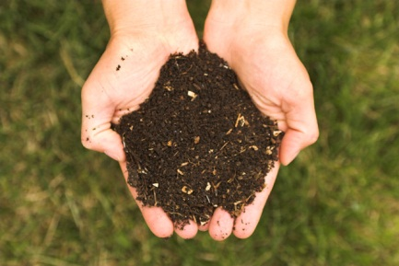
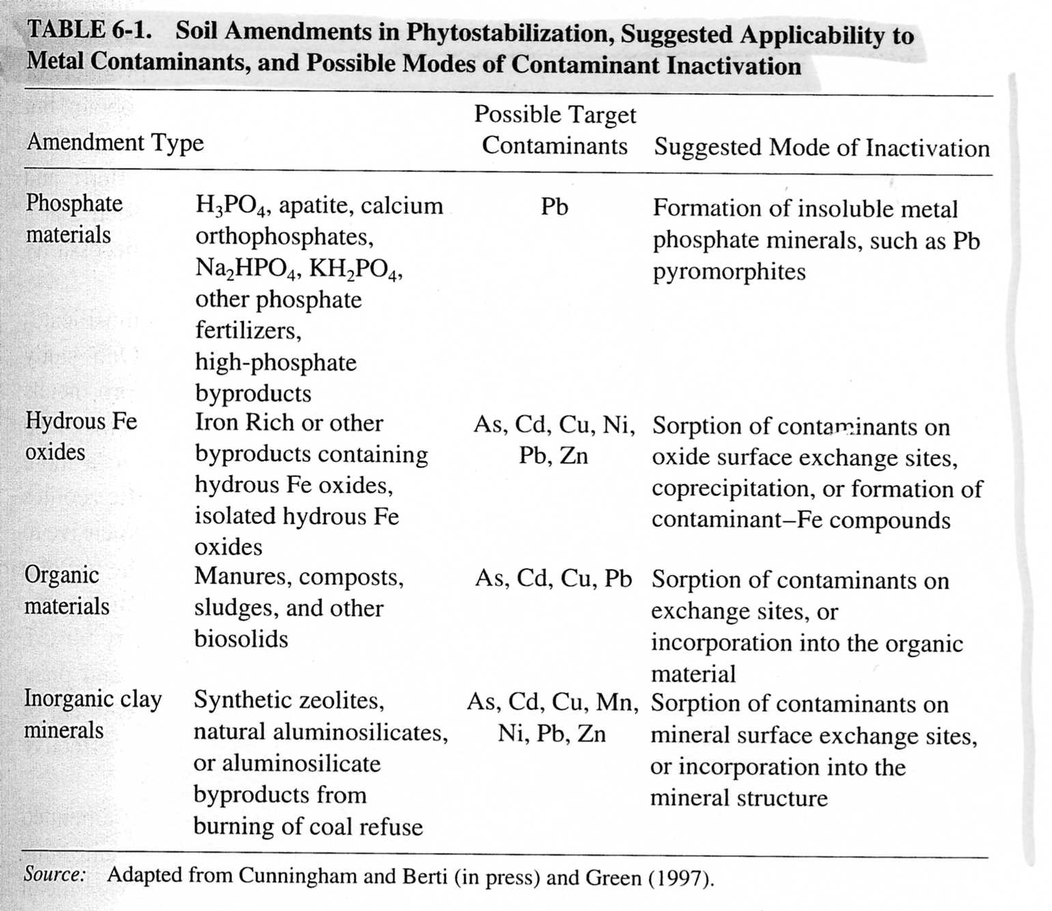
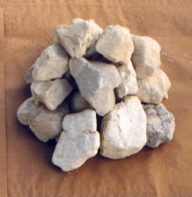
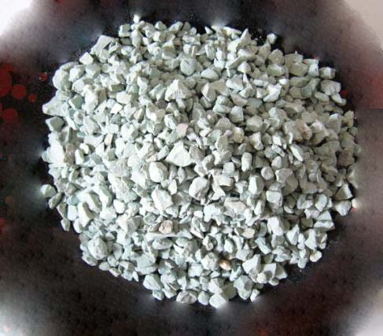
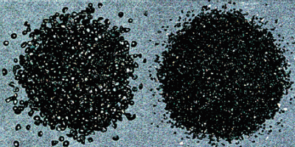
Aided phytostabilization
Use of chemical amendments?
compost
Lime
zeolite
+ Lime
+ Fly ashes
Iron pellet
Notes:
48
48

Slide 49
Aided phytostabilization
Use of chemical amendments?
Use of biological amendments?
  mycorhiza
  Endophyte bacteria and actinobacteria
  Positive effect on plant water and nutrient uptake
  Effect on pollutant uptake and effects??? (cf. case study Miscanthus)
Notes:
49
49

Slide 50
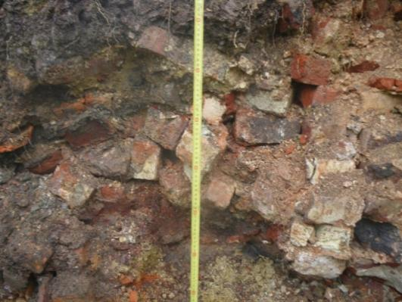
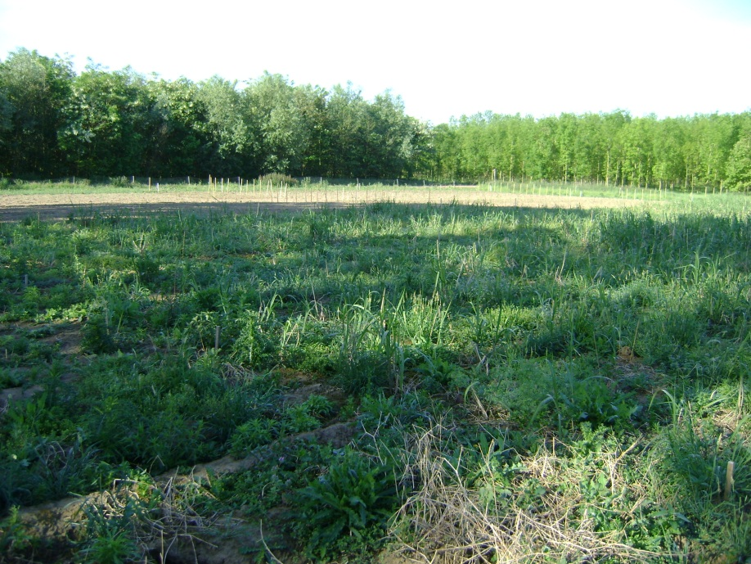
Phytostabilization
Which set-up and crop management?
  Work on soils (soil levelling… cf. case study l’Union)
  Soil preparation (amendments, stones removing…)
  Seeds, seedlings, rhizomes
  Irrigation
  Fertilization
  Pest control
  45% survival with rhizomes
  95% survival with seedlings
Notes:
50
50

Slide 51
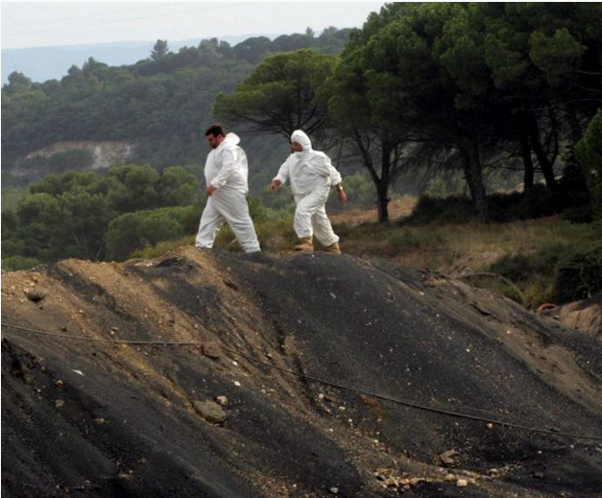
Phytostabilization
Efficiency evaluation and monitoring
  Measurement of soil covering (must be 100%)
  Measurement of pollutant transfer to plants
  Evaluation of transfer risk to ecosystem
  Evaluation of pollutant transfer to groundwater
  Evaluation of site biodiversity and functionality
Notes:
51
51

Slide 52
Aided phytostabilization
Use of chemical amendments?
Iron pellet
Notes:
52
52

Slide 53
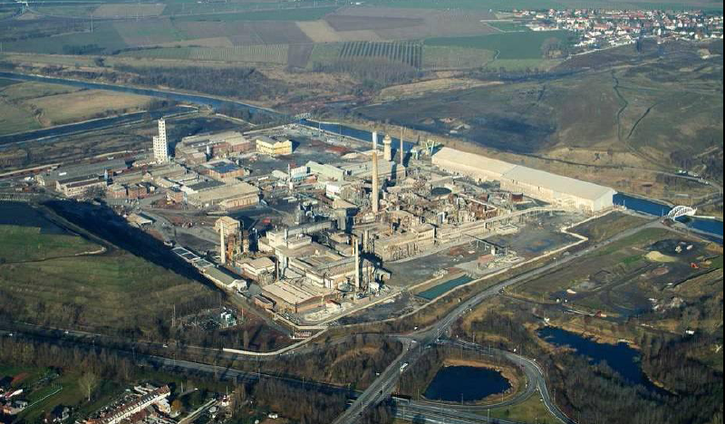
Case study: Metaleurop
MV
M1000

Slide 54
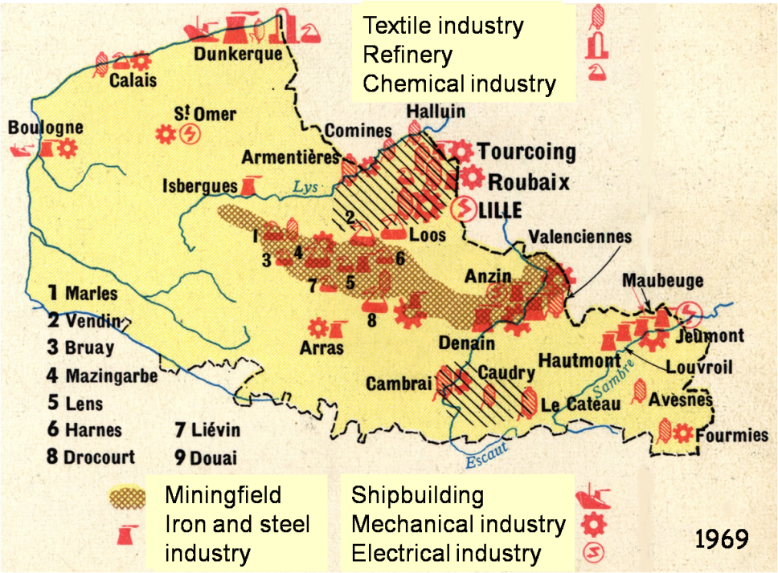
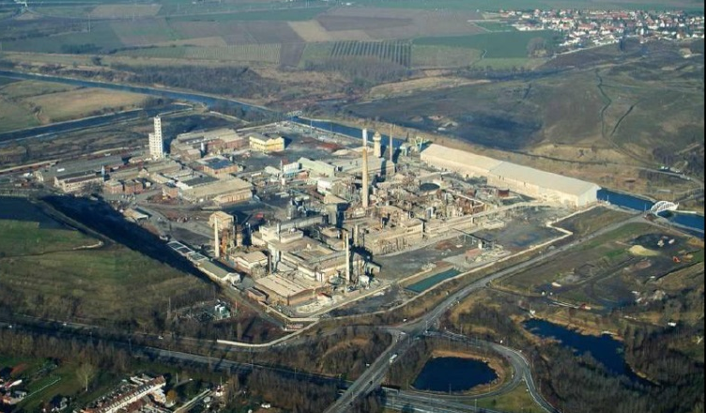
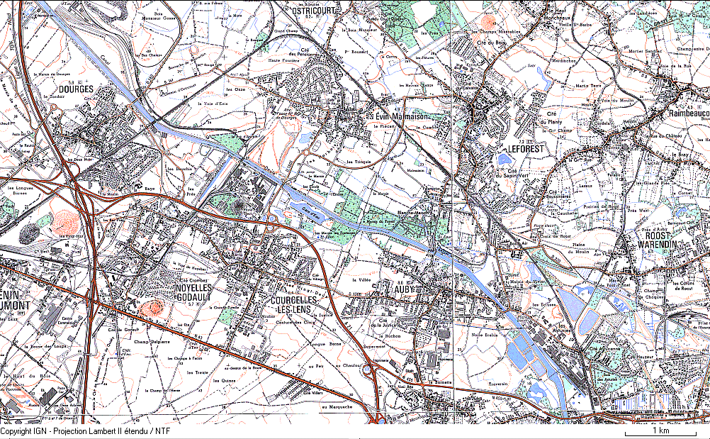
Regional context
Historical view
Metaleurop Nord
3 km
Nyrstar
Metaleurop Nord (1894-2003), the biggest lead smelter in Europe
Nyrstar, a zinc smelter in activity since 1869
Metaleurop Nord
Notes:
Nord-Pas de Calais: 571 polluted sites (13.8 % of French polluted sites)
Former coal-mining area
Metaleurop Nord (1894-2003) and Nyrstar (date): extractive metallurgies from imported ores
Metaleurop megasite: surroundings of the former Pb and Zn smelters

Slide 55
Metaleurop site
Agricultural soils (0 - 25 cm)
[metal] mg kg⁻¹ | Studied soils | Regional background
 | Min - Max | Median
Cd | 1.5 -15.7 | 0.4
Pb | 102 - 804 | 29
Zn | 154 - 1 083 | 67
Cd (t yr⁻¹)
Pb, Zn (t yr⁻¹)
Metaleurop Cd, Pb and Zn atmospheric emissions (tons /year)
* Douay et al, 2010, 2011 ** Sterckeman et al, 2002
Highest atmospheric emissions during the seventies, mainly Cd, Pb and Zn
  Level of Cd, Pb and Zn topsoil contamination : x 20 - 50 than regional agricultural background
  Other pollutants: As, Hg, Sb, Ag, Cu…

Slide 56
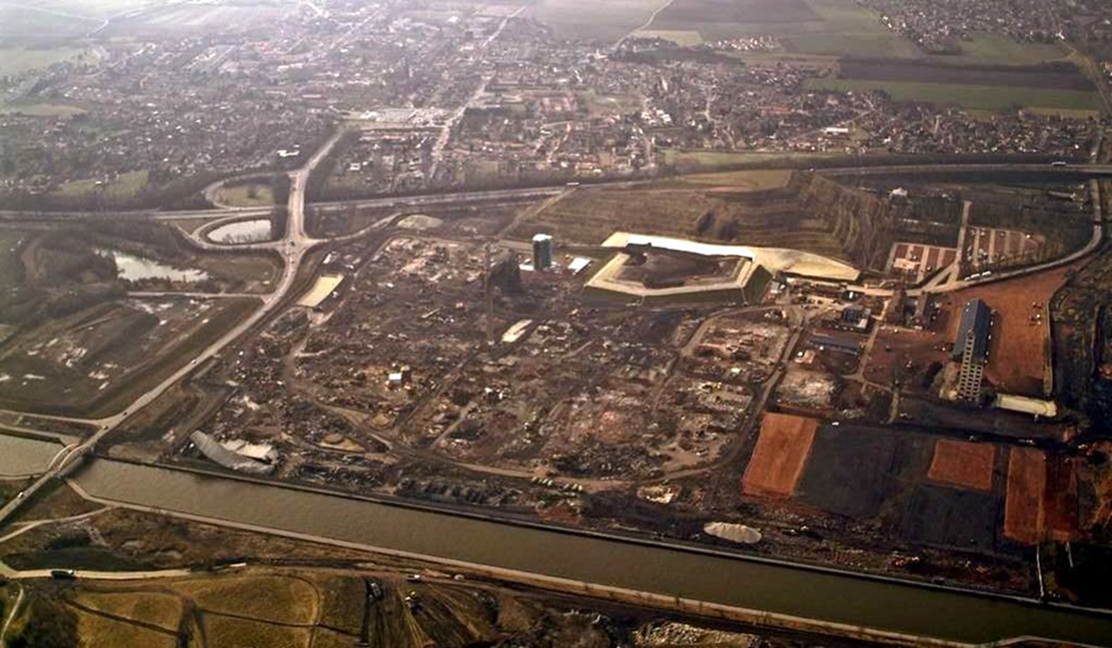
Metaleurop site
Site complexity
Nord
Pas de Calais
Various land uses (residential, agricultural, leisure, artisanal and tertiary sectors)
Numerous stakeholders and local authorities (Région, 2 Départements, 10 cities,
55 000 inhabitants, farmers…)
Strong urbanization, numerous axes of communication, few natural spaces
Large environmental degradation (landscape, habitat fragmentation…)

Slide 57
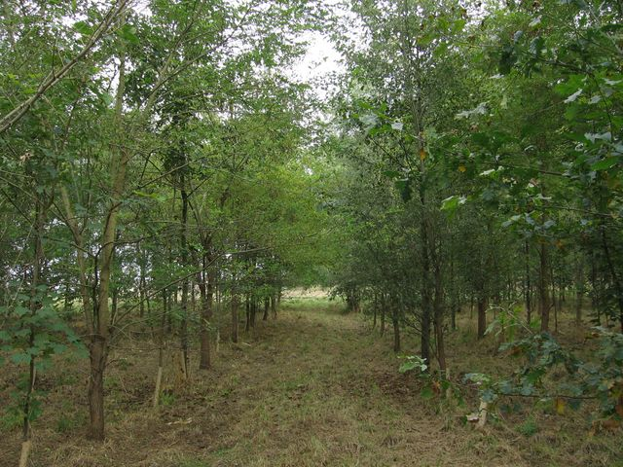
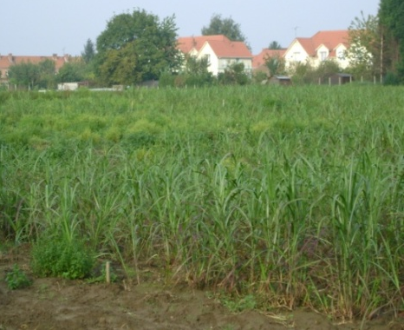
Management of Metaleurop site
The contaminated area is too large to be remediated in an economically relevant way by the currently applied remediation techniques
Interest of phytotechnologies?
Wood
Miscanthus x giganteus
PHYTOPOP and PHYTENER projects aimed at studying the phytomanagement of these soils: Phytostabilization in combination with biomass valorization

Slide 58
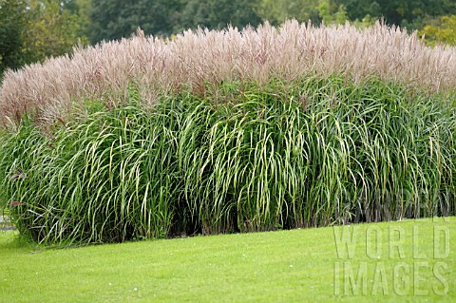
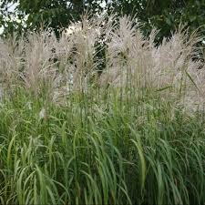
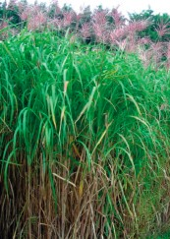
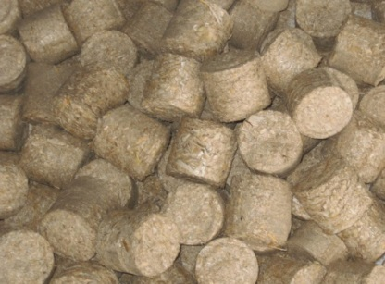
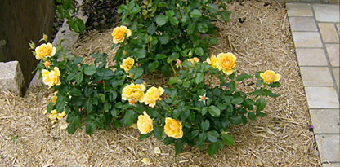

Miscanthus x giganteus
High yield: 15 - 30 t MS ha⁻¹
Few agricultural inputs
Perennial grass
Grow from tropical to temperate zones
Sterile, non invasive
Soil physical stabilisation
No tillage: no dispersion of contaminated dusts
Sequestration of CO₂
M. sinensis
2n = 38
M. sacchariflorus
2n = 76
M. × giganteus
2n = 57
Uses of the biomass
Energy production
Biofuels
Agricultural usage
Litter for animals…
Pellets
Mulch
Horse bedding

Slide 59
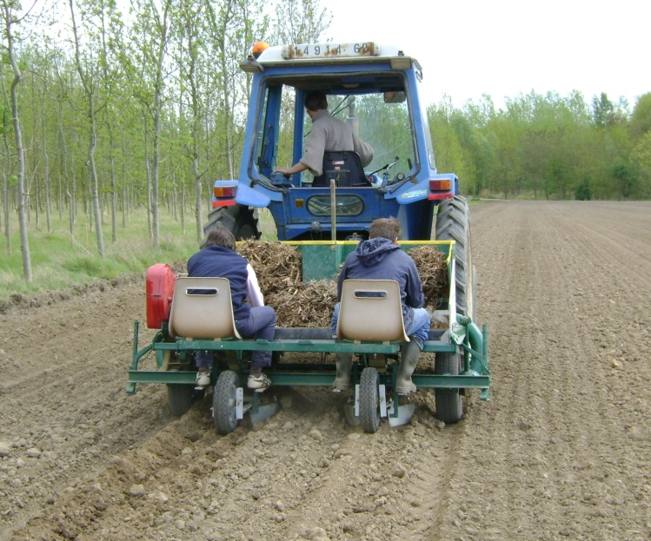
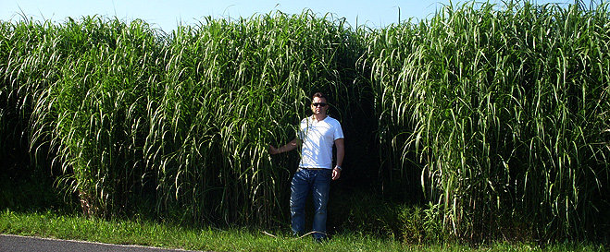
II. Miscanthus x giganteus potential for phytostabilization: in situ experiments
Ability to grow on contaminated soils
Metal accumulation in the plant organs

Slide 60
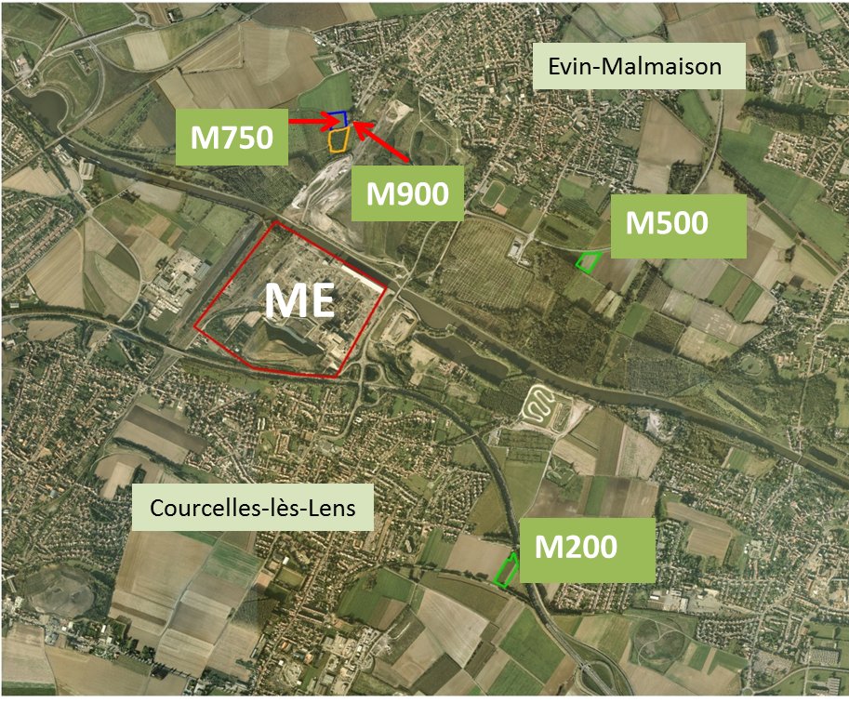
Soil and plant sampling
MC: 37 mg de Pb kg⁻¹
M200: 200 mg Pb kg⁻¹
M500: 500 mg Pb kg⁻¹
M750: 750 mg Pb kg⁻¹
M900: 900 mg Pb kg⁻¹
MC: uncontaminated agricultural plot taken as reference (75 km distant from the smelter)
Couple soil/plant:
Soil: 0 - 25 cm
Miscanthus: roots, rhizomes, stems and leaves

Slide 61


In situ experiments: plant growth
15 months after plantation
27 months after plantation
2nd year, July
3rd year, July
No visible toxicity symptoms
Competition with weeds (^{1st} and 2nd year)
Yield : 14 t DW ha⁻¹ after 3 years (Winter 2011)
After 6 years (Winter 2014)
Higher yield on contaminated sites
→ better agricultural potential?

Slide 62

Soil functionality
How to evaluate soil functionality?
Physical
Chemical
Metal concentrations
Pseudototal
Extractable
Bioavailable
Phytoavailable
Speciation
Soil health
Biological

Slide 63
Soil functionality
How to asses the soil biological parameters?
Biomass and activity
Biodiversity
Functional groups
Soil ecosystem services
Microbial biomass C, N and P
Soil respiration
Soil nitrification rate
Soil enzymatic activities
Microorganisms
Invertebrates
Species richness and variation
Microbial decomposers
Biological regulators (protists, nematodes)
Ecosystem engineers (earthworms, isopods)
Nutrient cycling
Soil fertility
Soil structure
Organic matter decomposition

Slide 64

Choice of soil functionality indicators
Cd, Pb and Zn
extractability
Physico-chemical
parameters
Biological parameters
CaCl₂ 0.01 M
pH
CEC
Available P₂O₅
OC
TN
Microbial biomass carbon (MBC)
Basal respiration (BR)
Fluorescein diacetate hydrolytic activity (FDHA)
Laccase
Acid phosphatase
Urease

Slide 65


Evolution of soil physico-chemical parameters
CEC and Organic Carbon: Ratio (T+1/T0)
Soil without miscanthus
Soil with miscanthus
In the miscanthus cultivated soils:
No pH variations detected
CEC and OC concentrations increased

Slide 66


Evolution of extractable metal concentrations
0.01 M CaCl₂ extractable metal concentrations: Ratio (T+1/T0)
Soil without miscanthus
Soil with miscanthus
CaCl₂ extractable portion of metals decreased in all treatments
Higher decrease in miscanthus cultivated soils
Pb concentrations always below the limit of detection

Slide 67

Evolution of soil biological parameters
Quantification of Microbial Biomass Carbon: Ratio (T+1/T0)
Soil without miscanthus
Soil with miscanthus
Very little MBC evolution in the unplanted soils
MBC significantly increased in miscanthus cultivated soils
Notes:
Dire problème dosage C dans C et UC

Slide 68

Evolution of soil biological parameters
Quantification of CO₂ released (Basal Respiration): Ratio (T+1/T0)
Soil without miscanthus
Soil with miscanthus
Slight increase without significant variations detected in the unplanted soils
Activity increased more in the miscanthus cultivated soils

Slide 69

Evolution of soil biological parameters
Quantification of fluorescein liberated upon FDA addition (FDHA): Ratio (T+1/T0)
Soil without miscanthus
Soil with miscanthus
Slight increase in the unplanted soils mainly the MC one
Activity greatly increased in the miscanthus cultivated soils

Slide 70

Evolution of soil biological parameters
Quantification of the oxidation rate of ABTS to ABTS⁺ (laccase): Ratio (T+1/T0)
Soil without miscanthus
Soil with miscanthus
Slight increase detected in the unplanted soils but no significant difference between soils
High increase in the miscanthus cultivated soils

Slide 71

Evolution of soil biological parameters
Quantification of p-nitrophenol released (acid phosphatase): Ratio (T+1/T0)
Soil without miscanthus
Soil with miscanthus
No significant increase and variations detected in the unplanted soils
Activity increased in the miscanthus cultivated soils

Slide 72

Evolution of soil biological parameters
Quantification of N released into soils (urease): Ratio (T+1/T0)
Slight increase without significant variations in the unplanted soils
Activity increased in the miscanthus cultivated soils

Slide 73

Impacts of miscanthus on enhancing the soil functionality
P₂O₅
OC
TN
MBC
BR
FDHA
Lignin degradation
OP mineralisation
Urea degradation
Metal extractability

Slide 74
Thank you for attention

